Slide 1
Multiple Hypothesis Testing With Persistent Homology
Mikael Vejdemo-Johansson
CUNY College of Staten Island
CUNY Graduate Center
Joint with Sayan Mukherjee

Slide 2
Hypothesis testing with persistence
Persistence diagrams form a probability space (Mileyko-Mukherjee-Harer) and we can define means, medians, variances (Turner et al), but the space is positively curved resulting in non-unique geodesics and hence non-unique means (Turner-Mileyko-Mukherjee-Harer).
Persistence landscapes: move to functions ℕxℝ→ℝ, work with pointwise central limit theorem (Bubenik).
Bootstrapped confidence regions: stability theorems put a bound on how much the diagram can vary – bootstrap estimates of this bound, put out boxes in the diagram half-plane (Chazal et al; Fasy et al).

Slide 3
Hypothesis testing with persistence
Two-sample hypothesis testing
Goodness of fit statistics to compare empirical distributions from diagrams from two groups (Blumberg et al)
Energy functional measuring in-group and out-group distances paired with permutation testing (Robinson-Turner)
Many-sample hypothesis testing
Energy functional approach adapted to many-sample setting (Cericola et al)

Slide 4
Multiple hypotheses
With many-sample testing comes a need for multiple hypothesis corrections.
Classically corrects for Family-Wise Error Rates (FWER) with methods such as Bonferroni.
Instead of rejecting at a threshold of 𝛼, reject at a threshold of 𝛼/m
FWER: control the probability of even one single erroneous rejection.
Bonferroni-style corrections drive up computational costs.

Slide 5
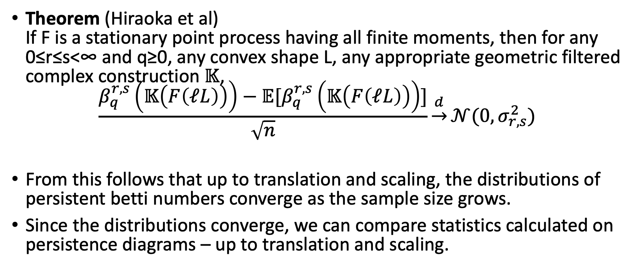
Our approach – foundations
Theorem (Hiraoka et al) If F is a stationary point process having all finite moments, then for any 0≤r≤s<∞ and q≥0, any convex shape L, any appropriate geometric filtered complex construction 𝕂, $\frac{β_{q}^{r,s}\left(𝕂\left(F\left(ℓL\right)\right)\right)−𝔼[β_{q}^{r,s}\left(𝕂\left(F\left(ℓL\right)\right)\right)]}{\sqrt{n}}\underset{→}{d}𝒩(0,σ_{r,s}^{2})$
From this follows that up to translation and scaling, the distributions of persistent betti numbers converge as the sample size grows.
Since the distributions converge, we can compare statistics calculated on persistence diagrams – up to translation and scaling.

Slide 6
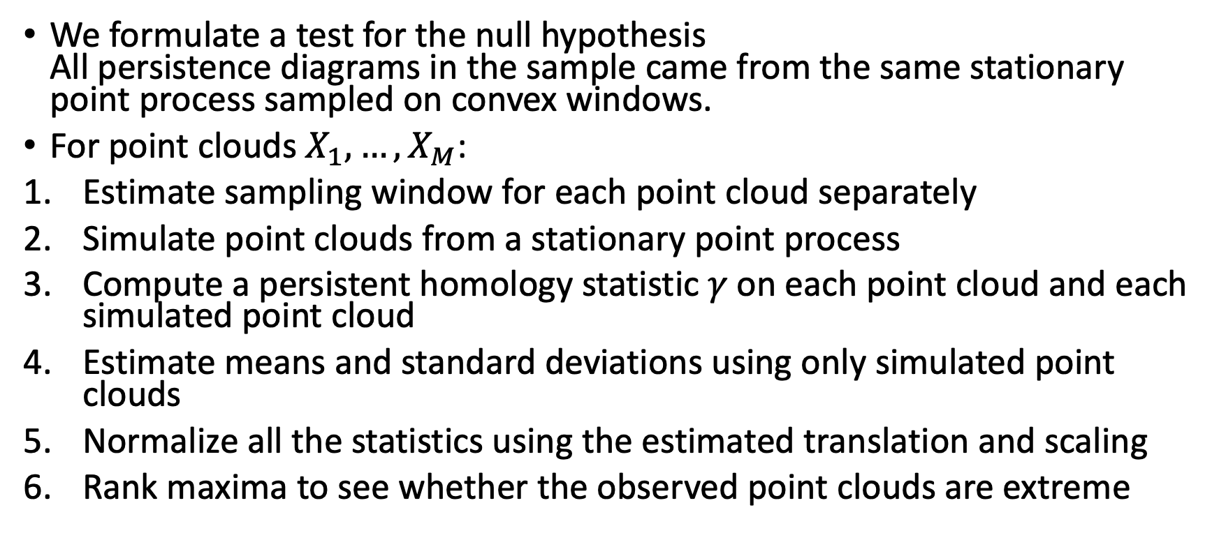
Our approach – hypothesis test
We formulate a test for the null hypothesis All persistence diagrams in the sample came from the same stationary point process sampled on convex windows.
For point clouds $X_{1},…,X_{M}$:
Estimate sampling window for each point cloud separately
Simulate point clouds from a stationary point process
Compute a persistent homology statistic 𝛾 on each point cloud and each simulated point cloud
Estimate means and standard deviations using only simulated point clouds
Normalize all the statistics using the estimated translation and scaling
Rank maxima to see whether the observed point clouds are extreme

Slide 7
Our approach – Matrix formulation
For clarity, consider observations placed in a column vector Expand to a MxN matrix by adding simulated point clouds in rows Each row contains simulations generated from a single point cloud
Use only the Mx(N-1) simulated point clouds to estimate translation and scaling row-wise Translate and scale the full matrix: row-wise z-scores
Consider each column to be one simulation step. Compute extreme z-scores column-wise.
Compare column extremes. Compute rank of the observed column among all columns.

Slide 8
Our approach – Does it work?
We calculate rejection rates
For point clouds drawn uniformly at random from axis-aligned boxes
For point clouds that include a single circle with Gaussian noise
We compare persistence diagrams using max(death-birth) or log(max(death-birth))
N in {100, 500}; M in {5, 10, 50} 2-dimensional boxes with side lengths in {0.1, 1, 10} Point counts for each point cloud in {10, 50, 100, 500} Isotropic Gaussian noise with variance in {0.1, 0.25} for the circle signal

Slide 9
Our approach – Does it work?
P< | Max length | Max log length
 | Null model
0.01 | 0.04 | 0.04
0.05 | 0.10 | 0.08
0.10 | 0.13 | 0.13
 | 𝜎 = 0.1
0.01 | 0.88 | 0.80
0.05 | 0.90 | 0.84
0.10 | 0.93 | 0.85
 | 𝜎 = 0.25
0.01 | 0.37 | 0.38
0.05 | 0.54 | 0.51
0.10 | 0.62 | 0.57

Slide 10
Thank you For your attention
arXiv:1812.06491
Also contains: False Discovery Rate correction both for our null model method and for Robinson-Turner’s energy functional method.

