Slide 1

Geometry and Topology in Data Science and Machine Learning
Mikael Vejdemo-Johansson
CUNY College of Staten Island – Mathematics
CUNY Graduate Center – Computer Science / Data Science

Slide 2
Roadmap
Topological Data Analysis
Use linear algebra to compute homology on data sets measuring their clusters, holes and bubbles.
Geometric Data Analysis
Use manifolds to estimate point cloud data.
Information Geometry
Use differentiable manifolds to study parametrized distributions.
Algebraic Statistics
Use algebraic geometry to study statistics – with bonus content: use category theory to study statistical models.

Slide 3

Unifying perspective:
Data has shape.
Shape matters.

Slide 4
Data has shape

Slide 5
Data has shape
The mean (or centroid) gives us a location for the data set

Slide 6
Data has shape
Variance (and covariance) measure how much and in what directions data spreads out.

Slide 7
Data has shape
PCA fits a best matching coordinate system to the data.

Slide 8
Data has shape
Clustering interprets the data as a collection of discrete unconnected points.

Slide 9

Shape matters
Your choice of data analysis tool imposes assumptions that your data may or may not obey.

Slide 10
Shape matters
Linear Regression assumes data is (close to) an affine hyperplane.
We have diagnostics to discover if this assumption is bad, and plans for when it is.

Slide 11
Shape matters
Machine Learning toolkits come with, inter alia, Decision Boundaries that may or may not have desirable properties:
Continuous? Smooth? Connected? Piece-wise linear?
We have approaches to measure the shapes of these Decision Boundaries.

Slide 12
Shape matters
When expanding our toolboxes, we want to control, and preferably limit, the implicit assumptions that our new tools place on our data.

Slide 13

Data has shape.
Shape matters.
How do we measure shape?
This talk describes four approaches:
Topological Data Analysis
Use algebraic topology, especially homology, to study shapes.
Geometric Data Analysis
Use Riemannian geometry, Differential geometry, and manifolds

Slide 14
Data has shape.
Shape matters.
How do we measure shape?
This talk describes four approaches:
Information Geometry
Model families in classical statistics have fruitful differentical geometrical properties.
Algebraic Statistics
Classic statistical constructions, model families, etc can have fruitful algebraic geometrical interpretations.

Slide 15

Topological Data Analysis

Slide 16
Represent Data with (Simplicial) Complexes
TDA has several popular approaches for data analysis. All of them build on representing data as a discrete topological space (ie simplicial complex):
(Persistent) Homology
(Persistent) Cohomology
Mapper
Homology uses linear algebra to find holes (…or bubbles, or higher-dimensional analogues)
Cohomology is the linear dual of homology, faster to compute, and can find circular coordinates.
Mapper constructs a simplicial complex model from data equipped with a lens function.

Slide 17


Persistence:
Simplicial Complexes from Data
The simplest construction to topologize data is the Čech complex at scale 𝜀:
Vertices are the data points
Connect vertices $x_{0},x_{2},…, x_{d}$ if the intersection of balls with radius 𝜀 centered at the vertices is non-empty

Slide 18
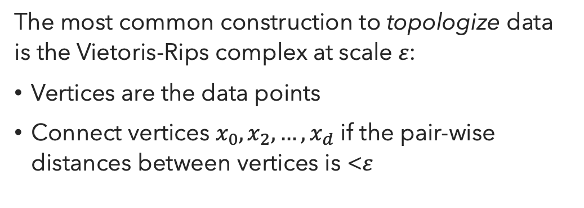
Persistence:
Simplicial Complexes from Data
The most common construction to topologize data is the Vietoris-Rips complex at scale 𝜀:
Vertices are the data points
Connect vertices $x_{0},x_{2},…, x_{d}$ if the pair-wise distances between vertices is <𝜀
The Vietoris-Rips complex is the clique complex of the Čech complex:
Add triangles (and tetrahedra, and higher simplices) for all cliques in the underlying graph.

Slide 19
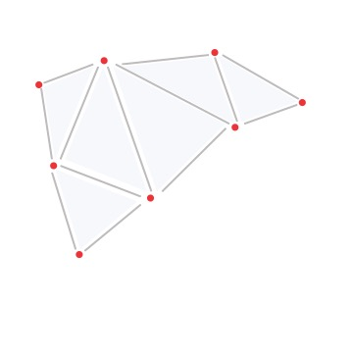
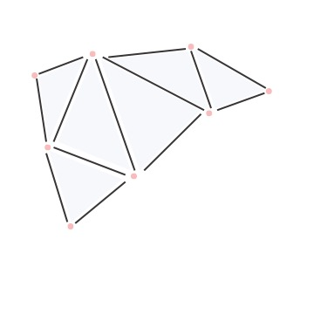
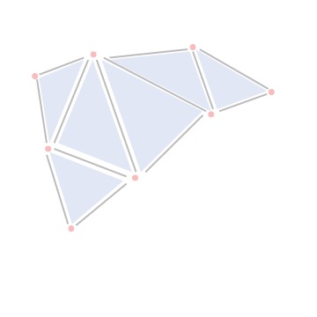



Persistence:
Homology:
Chains
With a simplicial complex in place, we can compute its homology – a vector space measuring holes and bubbles in the simplicial complex.
Break up the complex into building blocks.
Create vector spaces – one for each dimension – with the simplices as abstract basis set:
$$C_{0}$$
$$C_{1}$$
$$C_{2}$$

Slide 20
Persistence:
Homology:
Boundary Map
The boundary of a simplex is built out of simplices 1 dimension lower.
We can define a linear map by sending each simplex to a linear combination of its boundary simplices with alternating signs – then extend linearly.
This defines the boundary map ∂.

Slide 21
Persistence:
Homology:
Boundary Map
In a path of edges, the end-points appear in the boundary with opposite signs, cancelling each other out.
If end-points coincide (ie path forms a cycle), then the boundary is 0.

Slide 22
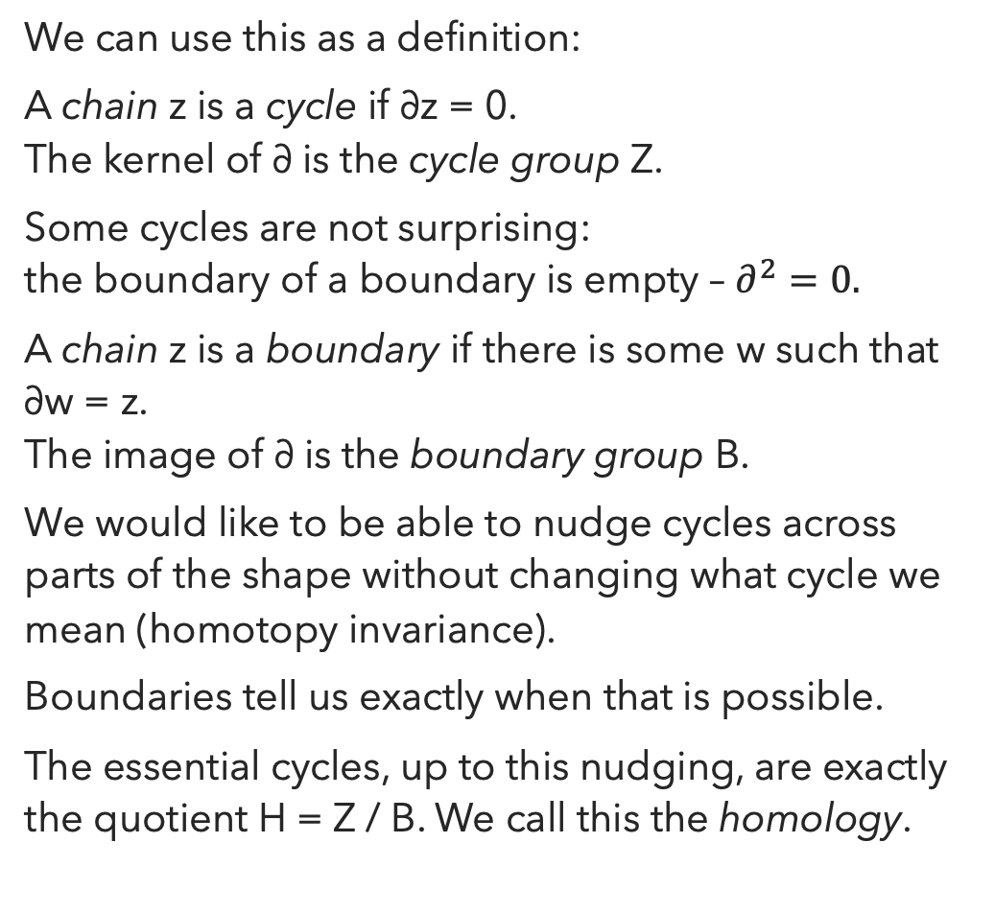
Persistence:
Homology, Cycles and Boundaries
We can use this as a definition:
A chain z is a cycle if ∂z = 0.
The kernel of ∂ is the cycle group Z.
Some cycles are not surprising:
the boundary of a boundary is empty – $∂^{2}=0.$
A chain z is a boundary if there is some w such that ∂w = z.
The image of ∂ is the boundary group B.
We would like to be able to nudge cycles across parts of the shape without changing what cycle we mean (homotopy invariance).
Boundaries tell us exactly when that is possible.
The essential cycles, up to this nudging, are exactly the quotient H = Z / B. We call this the homology.

Slide 23
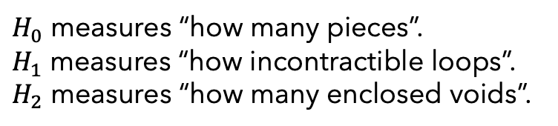
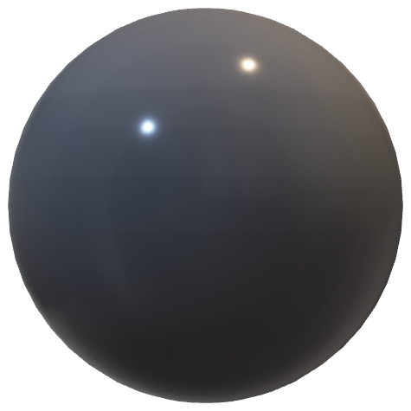
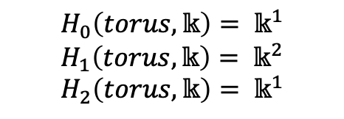
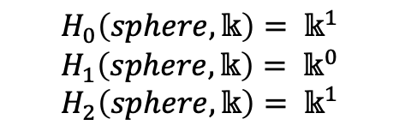
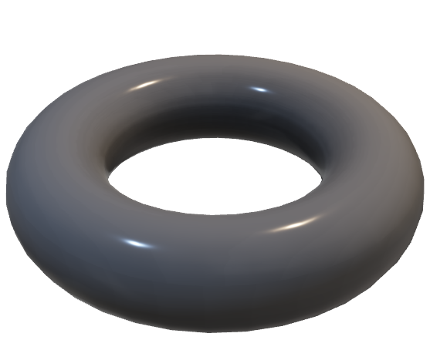
Persistence:
Homology
Some Examples
$$H_{0}\left(sphere, 𝕜\right)= 𝕜^{1}$$
$$H_{1}\left(sphere, 𝕜\right)= 𝕜^{0}$$
$$H_{2}\left(sphere, 𝕜\right)= 𝕜^{1}$$
$H_{0}$ measures “how many pieces”.
$H_{1}$ measures “how incontractible loops”.
$H_{2}$ measures “how many enclosed voids”.
$$H_{0}\left(torus, 𝕜\right)= 𝕜^{1}$$
$$H_{1}\left(torus, 𝕜\right)= 𝕜^{2}$$
$$H_{2}\left(torus, 𝕜\right)= 𝕜^{1}$$

Slide 24
Persistence:
What scale do we use?
We could try just picking some scale to work at.
But even small changes of scale can have dramatic effects on the detected features.
The solution: study all scales at once, using functoriality and representation theory.

Slide 25
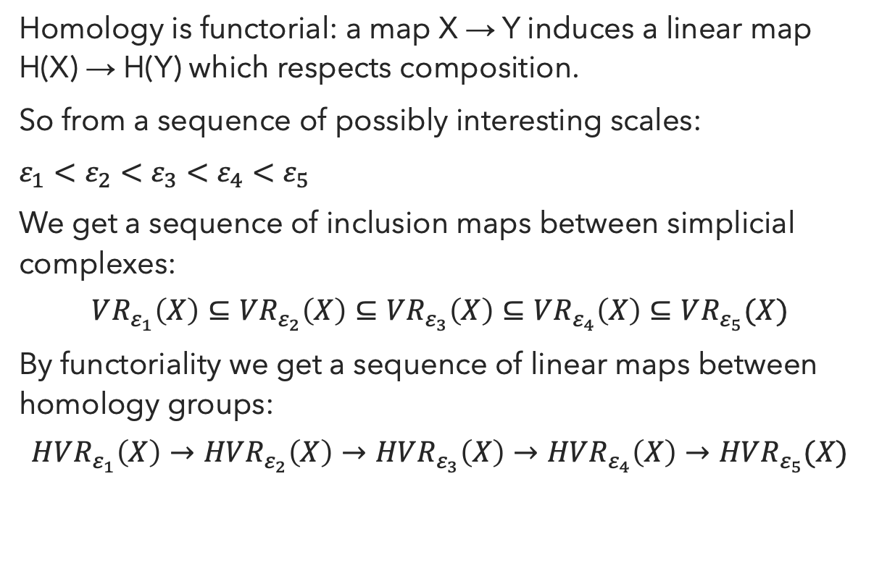
Persistence:
Functoriality
Homology is functorial: a map X → Y induces a linear map H(X) → H(Y) which respects composition.
So from a sequence of possibly interesting scales:
$ε_{1}<ε_{2}<$ $ε_{3}<$ $ε_{4}<$ $ε_{5}$
We get a sequence of inclusion maps between simplicial complexes:
$$VR_{ε_{1}}\left(X\right)⊆VR_{ε_{2}}\left(X\right)⊆VR_{ε_{3}}\left(X\right)⊆VR_{ε_{4}}\left(X\right)⊆VR_{ε_{5}}(X)$$
By functoriality we get a sequence of linear maps between homology groups:
$$HVR_{ε_{1}}\left(X\right)→HVR_{ε_{2}}\left(X\right)→HVR_{ε_{3}}\left(X\right)→HVR_{ε_{4}}\left(X\right)→HVR_{ε_{5}}(X)$$

Slide 26
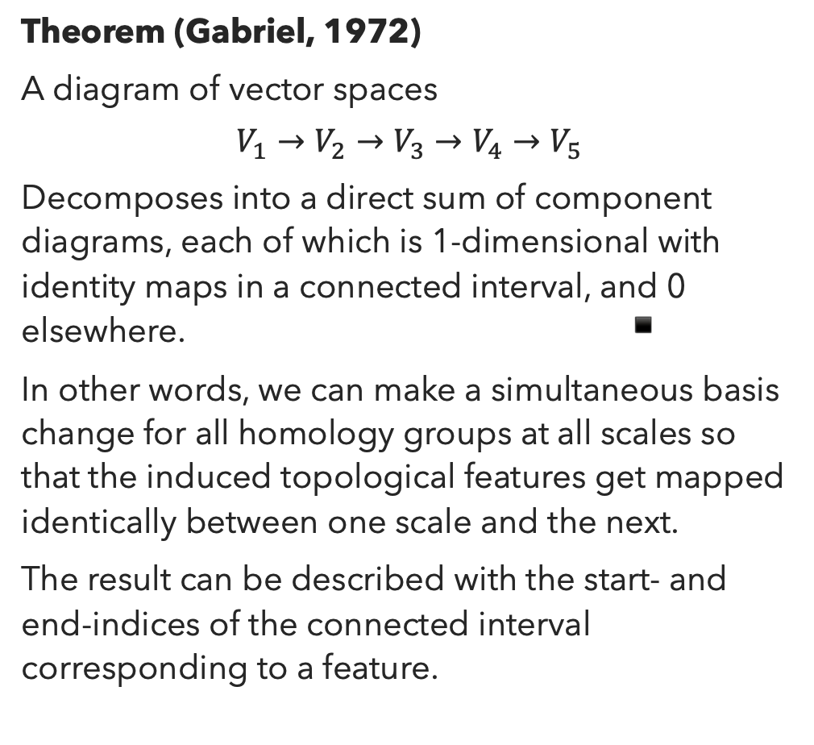
Persistence:
Representation Theory
Theorem (Gabriel, 1972)
A diagram of vector spaces
$$V_{1}→V_{2}→V_{3}→V_{4}→V_{5}$$
Decomposes into a direct sum of component diagrams, each of which is 1-dimensional with identity maps in a connected interval, and 0 elsewhere. ▪️
In other words, we can make a simultaneous basis change for all homology groups at all scales so that the induced topological features get mapped identically between one scale and the next.
The result can be described with the start- and end-indices of the connected interval corresponding to a feature.

Slide 27
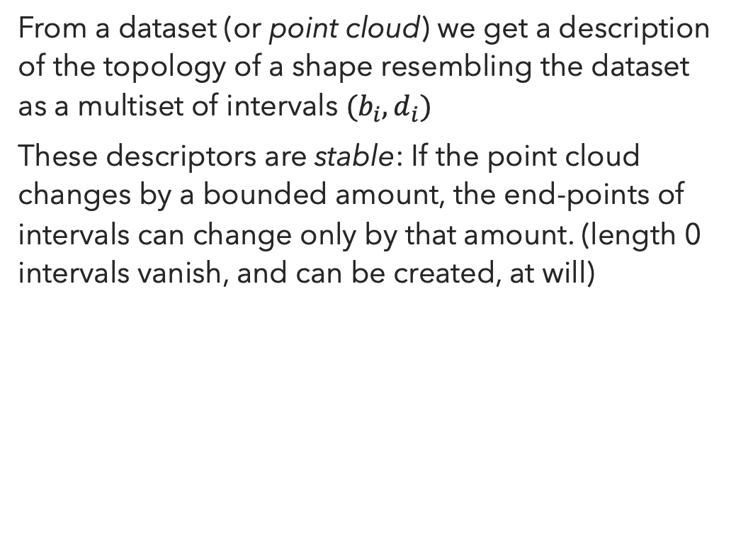
Persistent Homology
What do we get out of it?
From a dataset (or point cloud) we get a description of the topology of a shape resembling the dataset as a multiset of intervals $(b_{i},d_{i})$
These descriptors are stable: If the point cloud changes by a bounded amount, the end-points of intervals can change only by that amount. (length 0 intervals vanish, and can be created, at will)

Slide 28
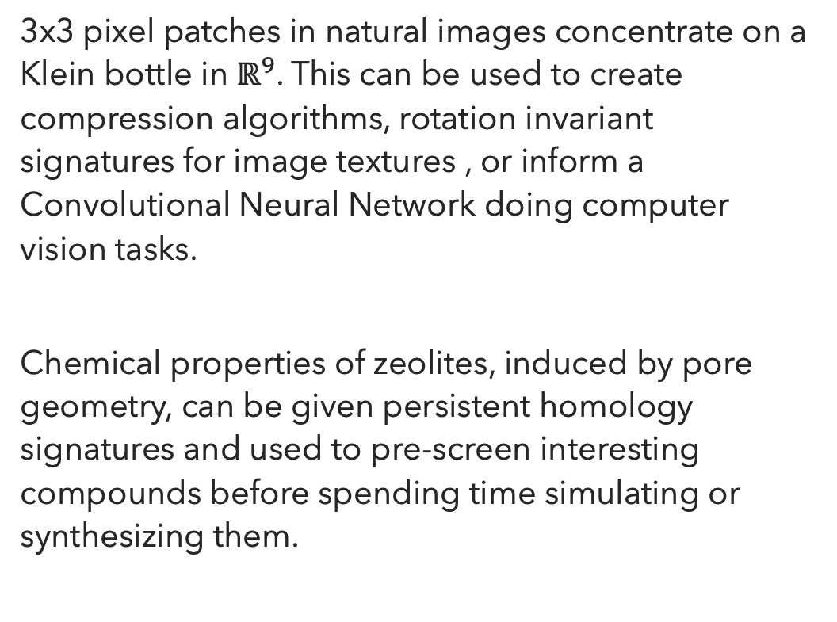
Persistent Homology
What do people do with it?
3x3 pixel patches in natural images concentrate on a Klein bottle in $ℝ^{9}$. This can be used to create compression algorithms, rotation invariant signatures for image textures , or inform a Convolutional Neural Network doing computer vision tasks.
Chemical properties of zeolites, induced by pore geometry, can be given persistent homology signatures and used to pre-screen interesting compounds before spending time simulating or synthesizing them.

Slide 29
Persistent Homology
Where can I learn more?
Carlsson, Gunnar. "Topology and data." Bulletin of the American Mathematical Society 46.2 (2009): 255-308.
Several books exist by now that focus on different aspects.
Release date February 2022:
Carlsson, Gunnar and Vejdemo-Johansson, Mikael. “Topological Data Analysis with Applications”. Cambridge University Press (2022).
Introduces all relevant topology and the persistence theory needed, and ends with a sequence of case studies where TDA is applied.

Slide 30

Geometric Data Analysis

Slide 31
Changing Meaning of Geometric Data Analysis
1960s – 1980s
Benzécri et al: Analyse des Données / Analyse des Correspondances.
Data is interpreted as point clouds. PCA and variations (MCA) adapted for categorical data used.
1980s-
Kendall: Shape manifolds, procrustean metrics and complex projective spaces.
Geometric shapes – up to rotation, scaling and translation – form manifolds parametrizing the shapes. Motivates development of statistics without vector space operations – Fréchet Means etc.
2000-
Manifold Learning – fit a nice manifold to an observed point cloud. Isomap / Locally-linear embeddings / Laplacian Eigenmaps / t-SNE / UMAP.

Slide 32
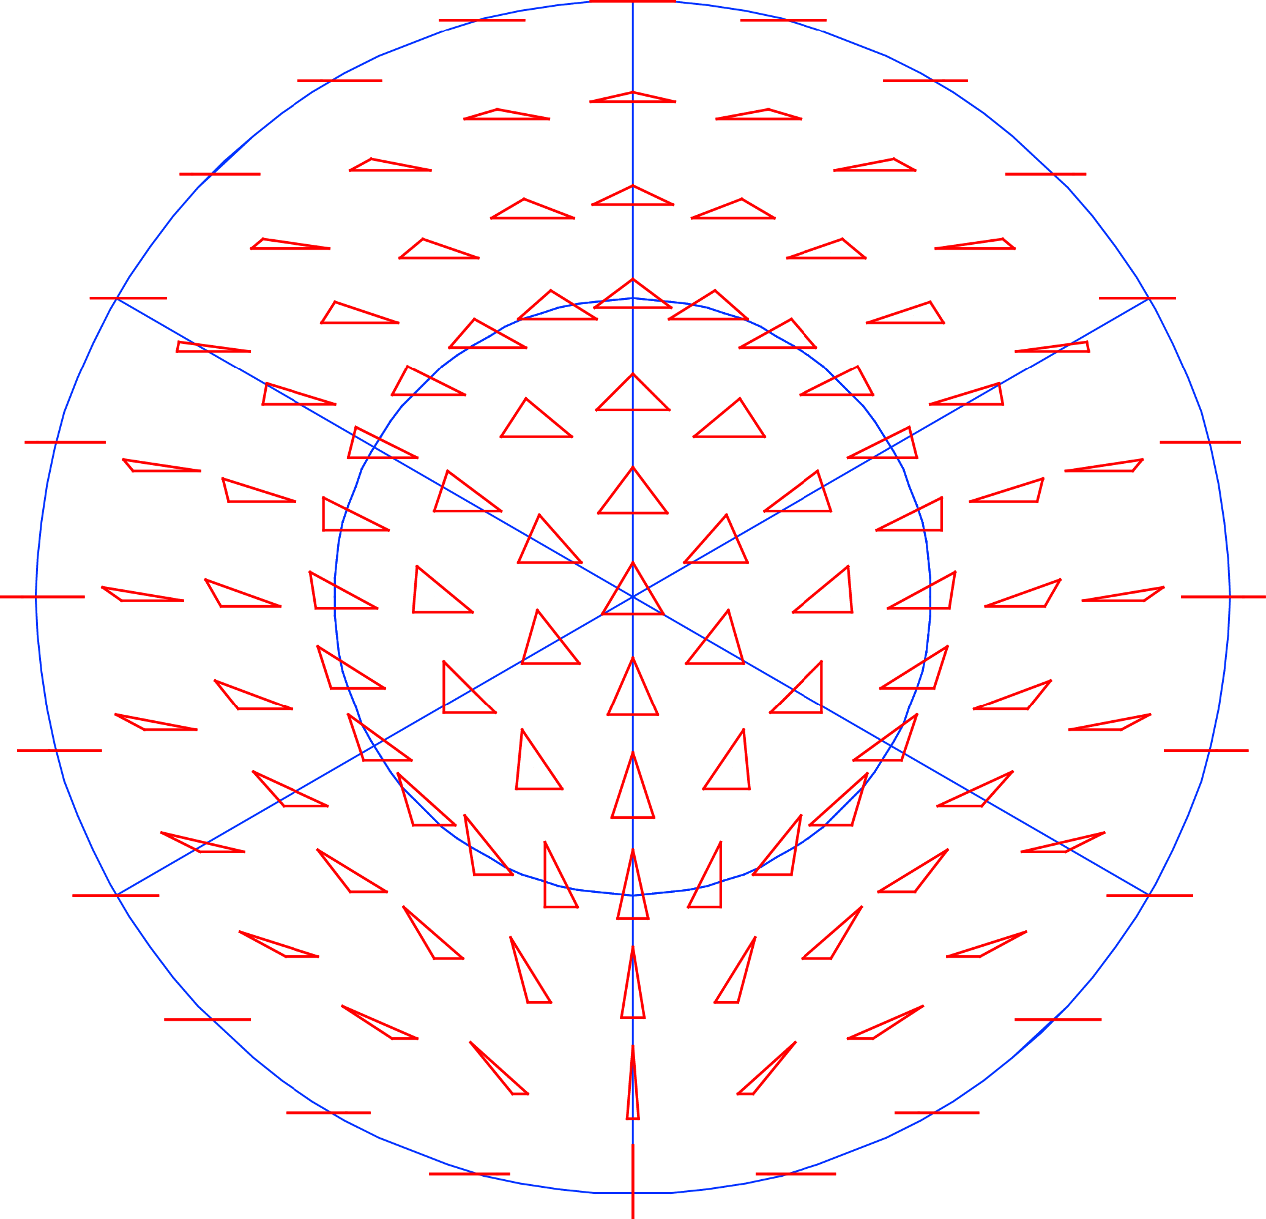
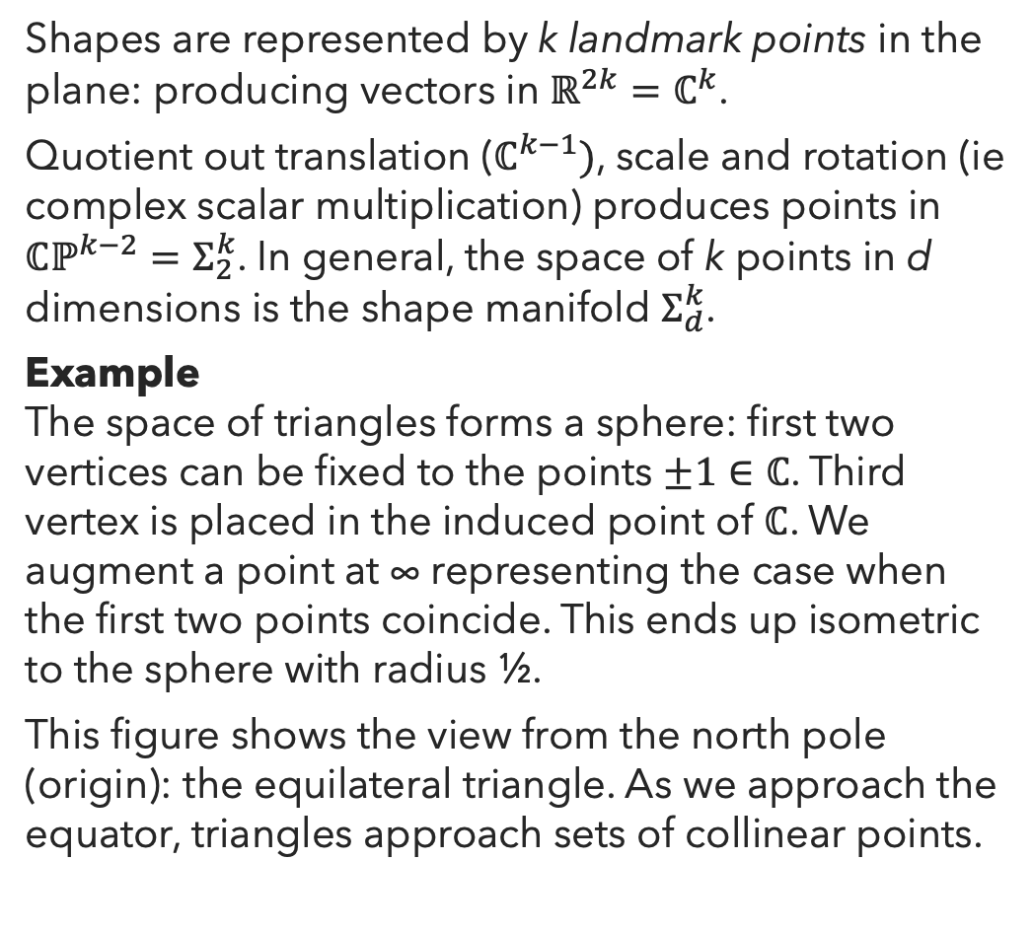
Kendall Shape Spaces
Shapes are represented by k landmark points in the plane: producing vectors in $ℝ^{2k}=ℂ^{k}$.
Quotient out translation ($ℂ^{k−1})$, scale and rotation (ie complex scalar multiplication) produces points in $ℂℙ^{k−2}=Σ_{2}^{k}$. In general, the space of k points in d dimensions is the shape manifold $Σ_{d}^{k}$.
Example
The space of triangles forms a sphere: first two vertices can be fixed to the points $±1∈ℂ$. Third vertex is placed in the induced point of $ℂ$. We augment a point at ∞ representing the case when the first two points coincide. This ends up isometric to the sphere with radius ½.
This figure shows the view from the north pole (origin): the equilateral triangle. As we approach the equator, triangles approach sets of collinear points.
Figure from Klingenberg 2015, https://doi.org/10.3390/sym7020843

Slide 33
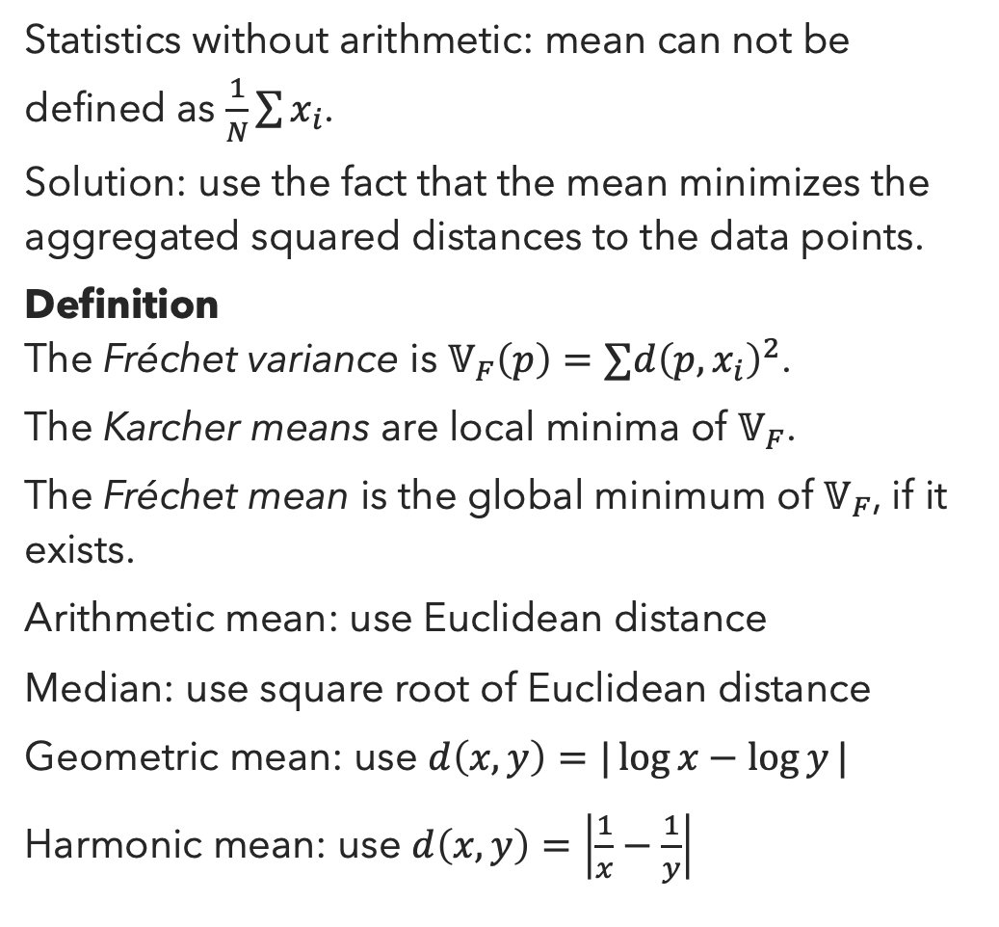
Fréchet Means
Statistics without arithmetic: mean can not be defined as $\frac{1}{N}\sum{x_{i}}$.
Solution: use the fact that the mean minimizes the aggregated squared distances to the data points.
Definition
The Fréchet variance is $𝕍_{F}\left(p\right)=∑d{\left(p,x_{i}\right)}^{2}$.
The Karcher means are local minima of $𝕍_{F}$.
The Fréchet mean is the global minimum of $𝕍_{F}$, if it exists.
Arithmetic mean: use Euclidean distance
Median: use square root of Euclidean distance
Geometric mean: use $d\left(x,y\right)=|\log{x}−\log{y}|$
Harmonic mean: use $d\left(x,y\right)=\left|\frac{1}{x}−\frac{1}{y}\right|$

Slide 34
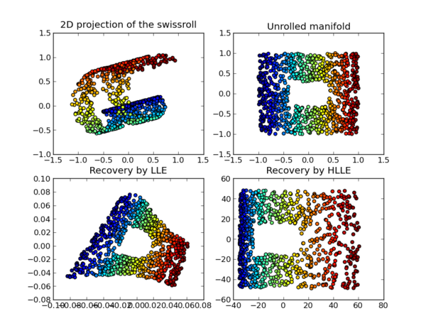
Manifold Learning
When a (Riemannian) manifold is embedded in a Euclidean space, geodesic and ambient distances might be very different.
Example
The Swiss Roll dataset has points sampled on the surface of a rolled-up square. Ambient distance methods (such as PCA) would put points near each other jumping the gap.
Many manifold learning techniques learn a nearest-neighbor graph and use graph distance as a proxy for geodesic distance.
Laplacian Eigenmaps: eigenmaps of graph Laplacian on NN-graph produce coordinates.
Isomap: Multidimensional Scaling (MDS) on weighted NN-graph distances.
Locally-Linear Embeddings: Barycentric coordinates for each point based on its neighbors. Minimize a cost function measuring reconstruction error using eigenvalues.
Figure by Oliver Grisel, CC-BY, Wikipedia

Slide 35
Geometric Data Analysis Resources
Geomstats – geomstats.github.io
Python package for computing with data on manifolds, for manifold learning, etc.
scikit-learn – scikit-learn.org
Python package for a wide range of machine learning tasks, including manifold learning.
GDAtools
R package for “old school” Geometric Data Analysis: correspondence analysis etc.
KeOps, GeomLoss
PyTorch packages for introducing geometric methods to deep learning.

Slide 36

Information Geometry

Slide 37
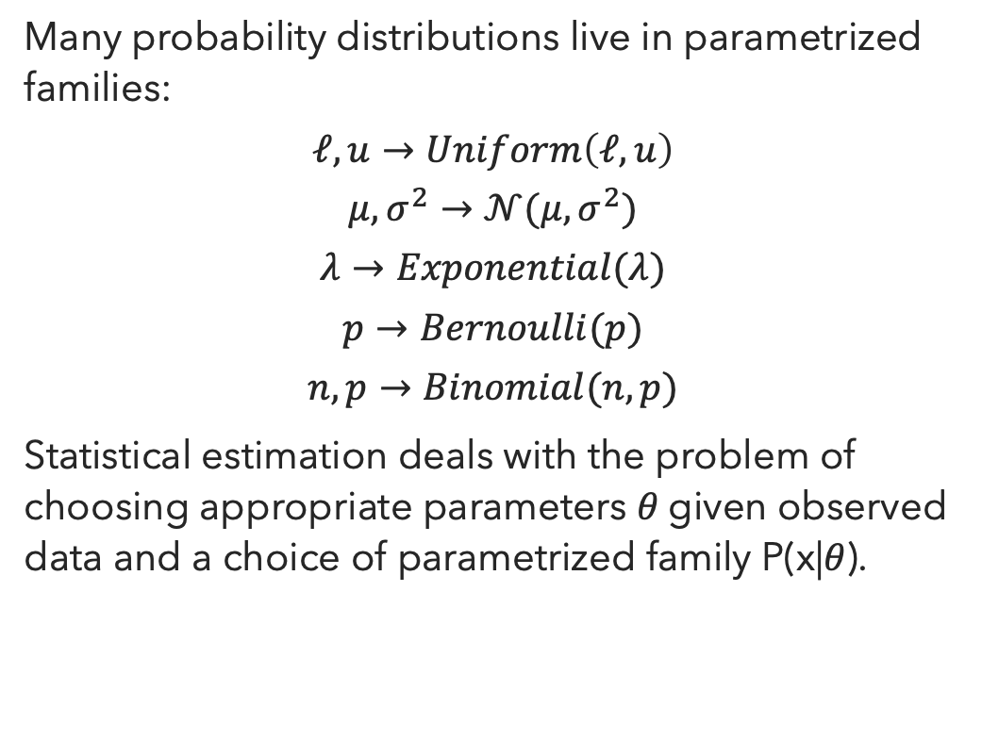
Parametrized Distributions
Many probability distributions live in parametrized families:
$$ℓ,u→Uniform\left(ℓ, u\right)$$
$$μ, σ^{2}→𝒩(μ,σ^{2})$$
$$λ→Exponential(λ)$$
$$p→Bernoulli(p)$$
$$n,p→Binomial(n,p)$$
Statistical estimation deals with the problem of choosing appropriate parameters 𝜃 given observed data and a choice of parametrized family P(x|𝜃).

Slide 38
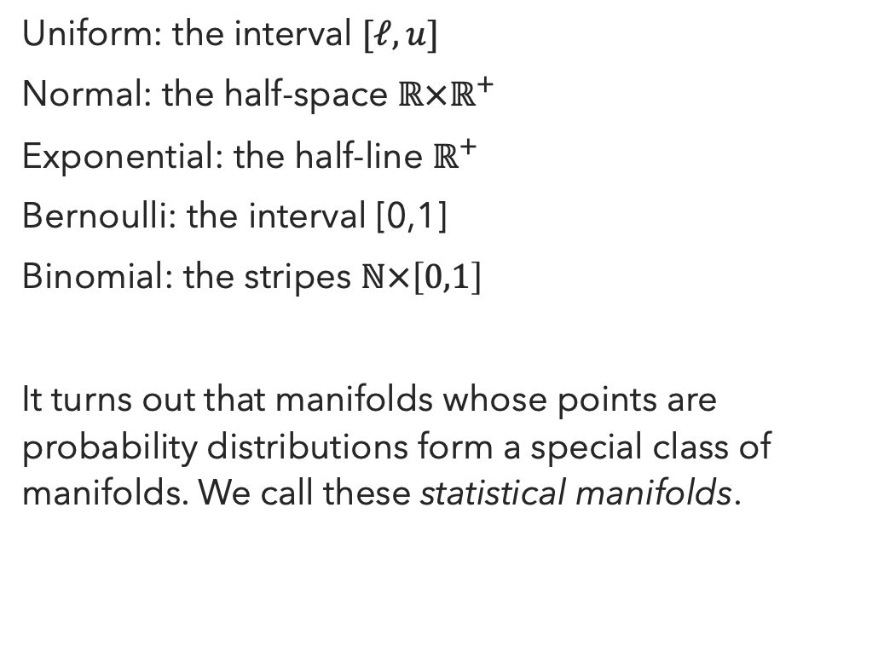
Parametrized Distributions
Parameters form Manifolds
Uniform: the interval $[ℓ, u]$
Normal: the half-space $ℝ×ℝ^{+}$
Exponential: the half-line $ℝ^{+}$
Bernoulli: the interval [0,1]
Binomial: the stripes $ℕ×\left[0,1\right]$
It turns out that manifolds whose points are probability distributions form a special class of manifolds. We call these statistical manifolds.

Slide 39
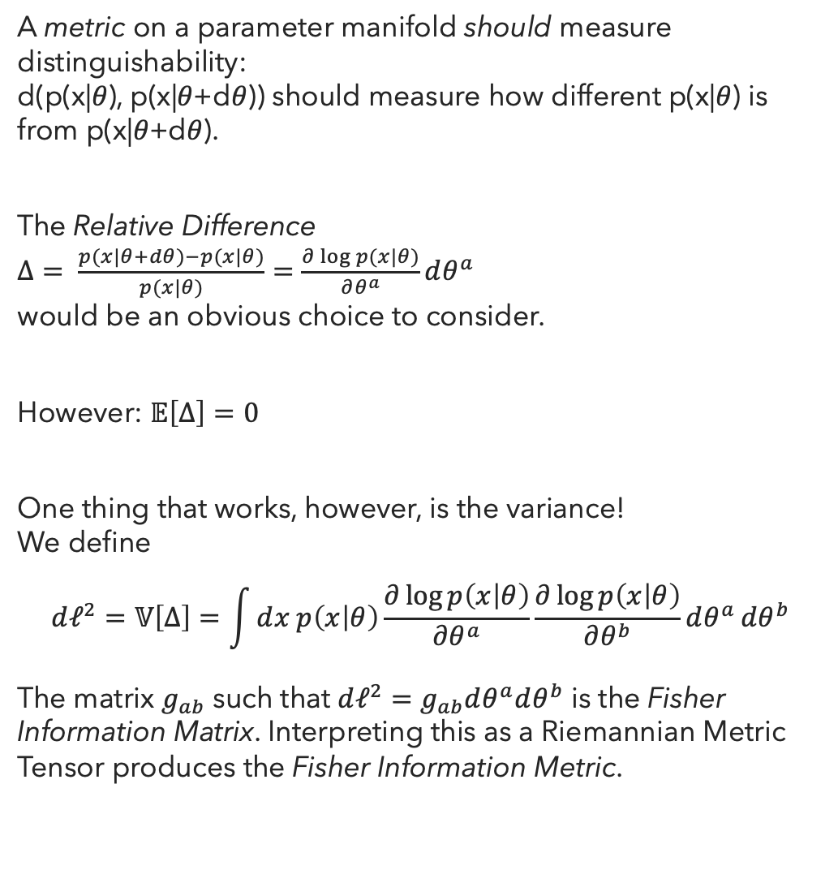
Information Metric
A metric on a parameter manifold should measure distinguishability:
d(p(x|𝜃), p(x|𝜃+d𝜃)) should measure how different p(x|𝜃) is from p(x|𝜃+d𝜃).
The Relative Difference
$Δ= \frac{p(x|θ+dθ)−p(x|θ)}{p(x|θ)}=\frac{∂\log{p(x|θ)}}{∂θ^{a}}dθ^{a}$
would be an obvious choice to consider.
However: $𝔼\left[Δ\right]=0$
One thing that works, however, is the variance!
We define
$$dℓ^{2}=𝕍\left[Δ\right]=\int{ⅆx p\left(x | θ\right)\frac{∂\log{p\left(x | θ\right)}}{∂θ^{a}}\frac{∂\log{p\left(x | θ\right)}}{∂θ^{b}}ⅆθ^{a}ⅆθ^{b}}$$
The matrix $g_{ab}$ such that $dℓ^{2}=g_{ab}dθ^{a}dθ^{b}$ is the Fisher Information Matrix. Interpreting this as a Riemannian Metric Tensor produces the Fisher Information Metric.

Slide 40
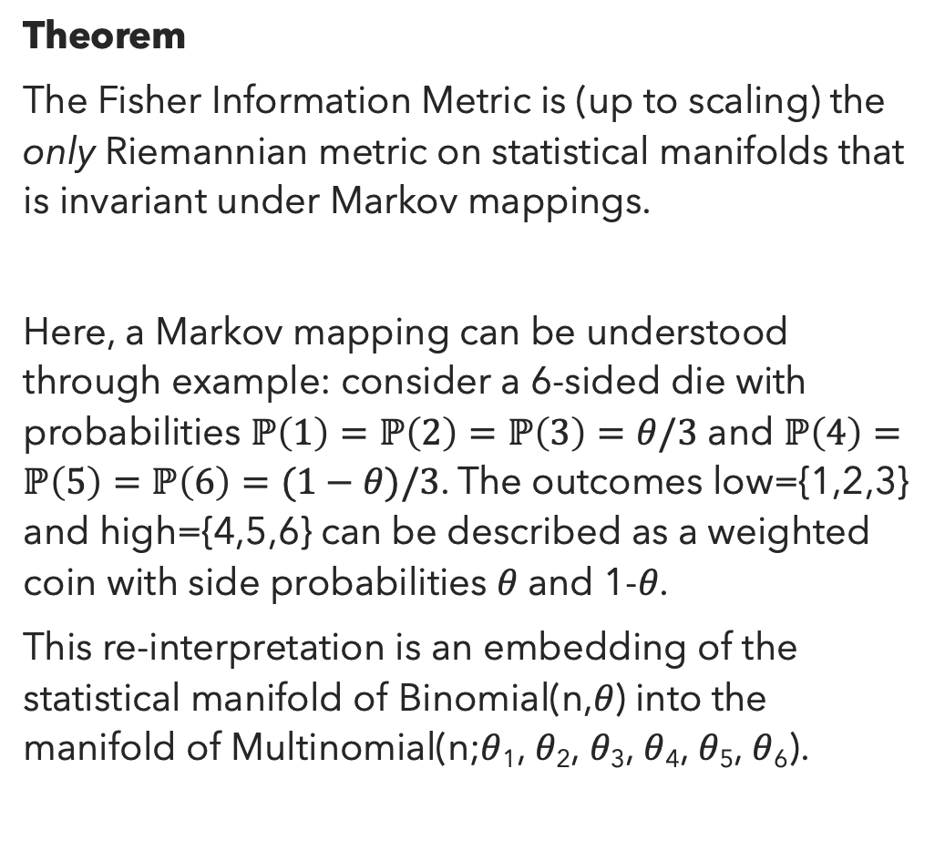
Chentsov’s Theorem
(aka Čencov, Ченцов)
Theorem
The Fisher Information Metric is (up to scaling) the only Riemannian metric on statistical manifolds that is invariant under Markov mappings.
Here, a Markov mapping can be understood through example: consider a 6-sided die with probabilities $ℙ\left(1\right)=ℙ\left(2\right)=ℙ\left(3\right)=θ/3$ and $ℙ\left(4\right)=ℙ\left(5\right)=ℙ\left(6\right)=(1−θ)/3$. The outcomes low={1,2,3} and high={4,5,6} can be described as a weighted coin with side probabilities 𝜃 and 1-𝜃.
This re-interpretation is an embedding of the statistical manifold of Binomial(n,𝜃) into the manifold of Multinomial(n;𝜃₁, 𝜃₂, 𝜃₃, 𝜃₄, 𝜃₅, 𝜃₆).

Slide 41
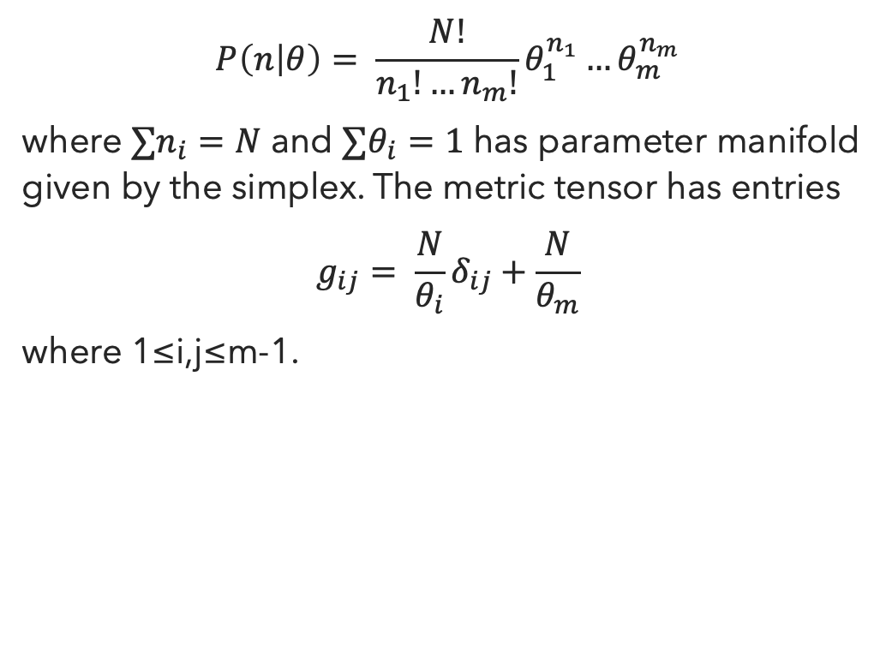
Example:
Multinomial Distributions
$$P\left(n | θ\right)= \frac{N!}{n_{1}!…n_{m}!}θ_{1}^{n_{1}}…θ_{m}^{n_{m}}$$
where $∑n_{i}=N$ and $∑θ_{i}=1$ has parameter manifold given by the simplex. The metric tensor has entries
$$g_{ij}= \frac{N}{θ_{i}}δ_{ij}+\frac{N}{θ_{m}}$$
where 1≤i,j≤m-1.

Slide 42
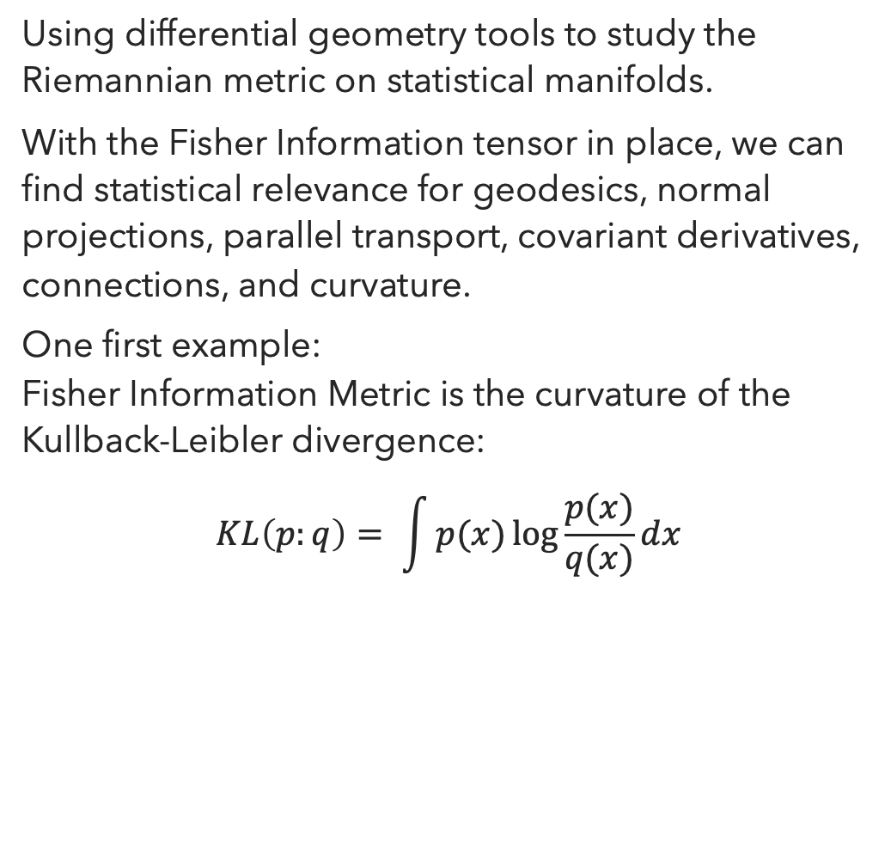
So… what is Information Geometry?
Using differential geometry tools to study the Riemannian metric on statistical manifolds.
With the Fisher Information tensor in place, we can find statistical relevance for geodesics, normal projections, parallel transport, covariant derivatives, connections, and curvature.
One first example:
Fisher Information Metric is the curvature of the Kullback-Leibler divergence:
$$KL\left(p:q\right)= \int{p(x)\log{\frac{p(x)}{q(x)}ⅆx}}$$

Slide 43
What makes me excited about it?
Baudot and Bennequin, The Homological Nature of Entropy, MDPI Entropy 2015, 17, 3253-3318.
Using homological algebra tools, a topological space is constructed such that: degree 1 cohomology is one-dimensional, and generated by the Shannon entropy function.
Bradley, Entropy as a Topological Operad Derivation, MDPI Entropy 2021, 23 (9), 1195.
Shannon entropy defines a derivation of the operad of topological simplices, and for every derivation of this operad, at some point it is a constant multiple of Shannon entropy.

Slide 44
Where can I learn more?
This section was heavily informed by:
Caticha, The basics of information geometry. AIP Conference Proceedings 1641, 15 (2015).
Canonical reference:
Amari and Nagaoka, Methods of Information Geometry. AMS / Oxford University Press, (2000)

Slide 45

Algebraic Statistics

Slide 46
What is Algebraic Statistics?
The application of algebraic geometry to problems in statistics and probability.
1998 Diaconis and Sturmfels
Conditional inference – random walks on contingency tables correspond to generating sets of toric ideals.
2001 Pistone, Riccomagno and Wynn
Experimental Design using Gröbner Bases
2005 Pachter and Sturmfels
Algebraic Statistics in Computational Biology
2005 Studený
Combinatorics of conditional independence structures
2009 Drton, Sturmfels and Sullivant
Oberwolfach Lecture Notes.
2012 Aoki, Hara and Takemura
Markov Bases
2016 Zwiernik
Tree models using real algebraic geometry
2018 Sullivant
Broad overview of the field.

Slide 47
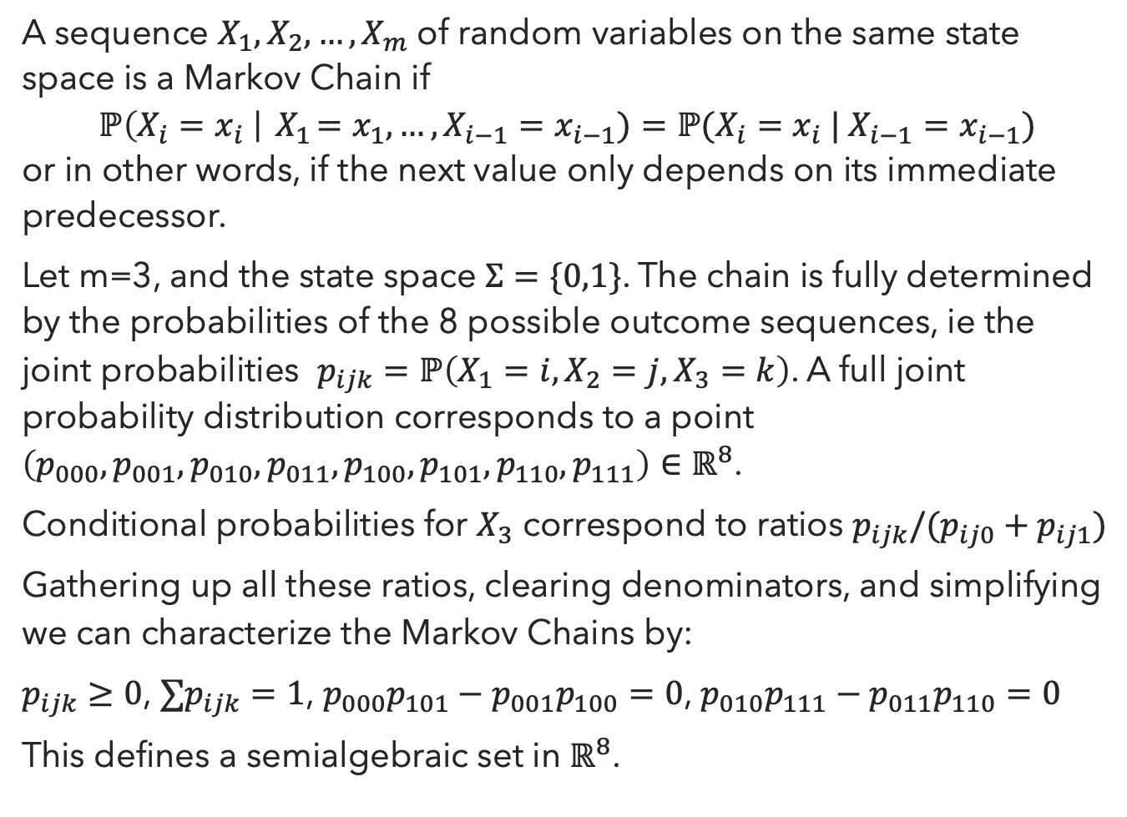
Example:
Markov Chains
A sequence $X_{1},X_{2},…, X_{m}$ of random variables on the same state space is a Markov Chain if
$$ℙ\left(X_{i}=x_{i} \right|{ X}_{1}=x_{1},…,X_{i−1}=x_{i−1})=ℙ(X_{i}=x_{i} | X_{i−1}=x_{i−1})$$
or in other words, if the next value only depends on its immediate predecessor.
Let m=3, and the state space $Σ=\{0,1\}$. The chain is fully determined by the probabilities of the 8 possible outcome sequences, ie the joint probabilities $p_{ijk}=ℙ\left(X_{1}=i,X_{2}=j,X_{3}=k\right)$. A full joint probability distribution corresponds to a point $\left(p_{000},p_{001},p_{010},p_{011},p_{100},p_{101},p_{110},p_{111}\right)∈ℝ^{8}$.
Conditional probabilities for $X_{3}$ correspond to ratios $p_{ijk}/(p_{ij0}+p_{ij1})$
Gathering up all these ratios, clearing denominators, and simplifying we can characterize the Markov Chains by:
$p_{ijk}≥0$, $∑p_{ijk}=1$, $p_{000}p_{101}−p_{001}p_{100}=0$, $p_{010}p_{111}−p_{011}p_{110}=0$
This defines a semialgebraic set in $ℝ^{8}$.

Slide 48
Key Features of Algebraic Statistics
(Very many) Statistical Models are semialgebraic sets.
Parametric Statistical Models are (often) polynomial functions of their parameters.
Estimation and model fitting corresponds to finding points on varieties or semialgebraic sets.
Hypothesis testing of model fit corresponds to checking whether a point is on a given variety.

Slide 49
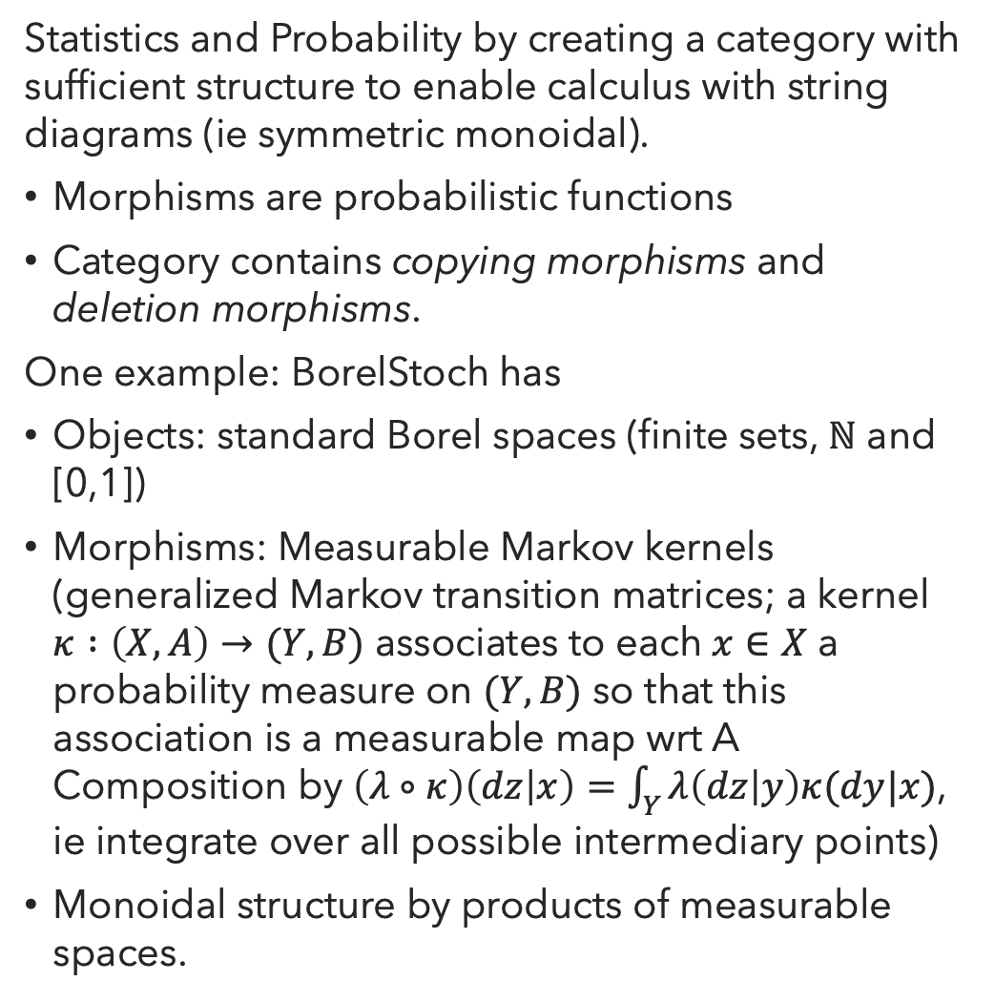
Beyond Algebraic Statistics:
Categorical Statistics
Statistics and Probability by creating a category with sufficient structure to enable calculus with string diagrams (ie symmetric monoidal).
Morphisms are probabilistic functions
Category contains copying morphisms and deletion morphisms.
One example: BorelStoch has
Objects: standard Borel spaces (finite sets, ℕ and [0,1])
Morphisms: Measurable Markov kernels
(generalized Markov transition matrices; a kernel $κ :\left(X,A\right)→(Y,B)$ associates to each $x∈X$ a probability measure on $(Y,B)$ so that this association is a measurable map wrt A
Composition by $\left(λ∘κ\right)\left(dz | x\right)=\int_{Y}{λ\left(dz | y\right)κ(dy|x)}$, ie integrate over all possible intermediary points)
Monoidal structure by products of measurable spaces.

Slide 50



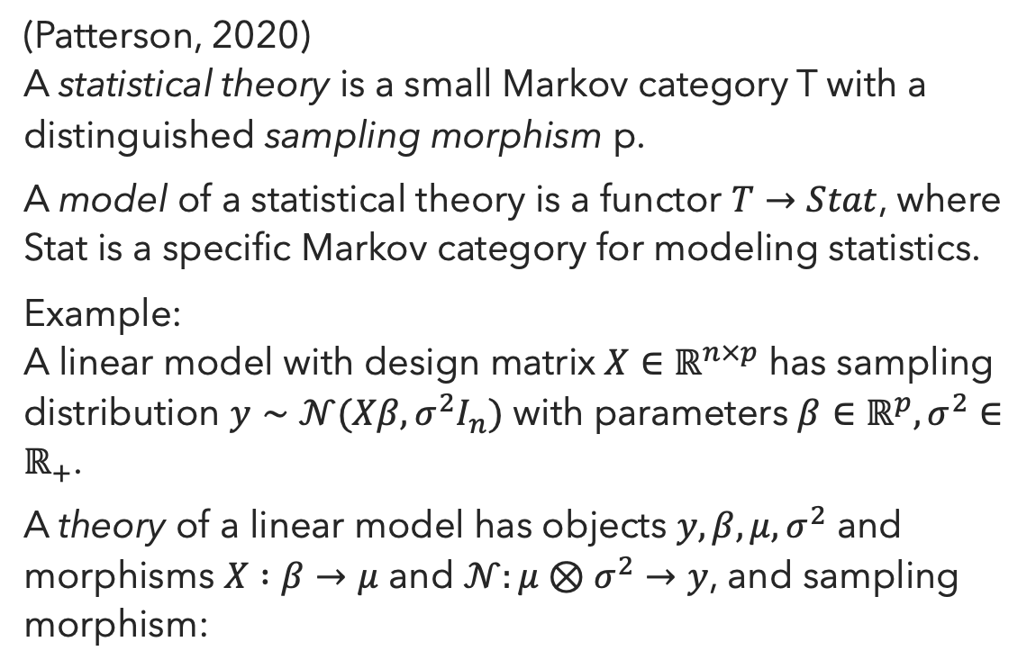






Categorical Statistics:
Theories and Models
(Patterson, 2020)
A statistical theory is a small Markov category T with a distinguished sampling morphism p.
A model of a statistical theory is a functor $T→Stat$, where Stat is a specific Markov category for modeling statistics.
Example:
A linear model with design matrix $X∈ℝ^{n×p}$ has sampling distribution $y∼𝒩(Xβ,σ^{2}I_{n})$ with parameters $β∈ℝ^{p}, σ^{2}∈ℝ_{+}$.
A theory of a linear model has objects $y, β, μ, σ^{2}$ and morphisms $X :β→μ$ and $𝒩:μ⊗σ^{2}→y$, and sampling morphism:
$$β$$
$$ℝ^{p}$$
Theory
X
$$σ^{2}$$
Linear map
$$ℝ_{+}$$
Model
$$μ$$
$$ℝ^{n}$$
$$𝒩$$
Isotropic normal sample
$$y$$
$$ℝ^{n}$$

Slide 51

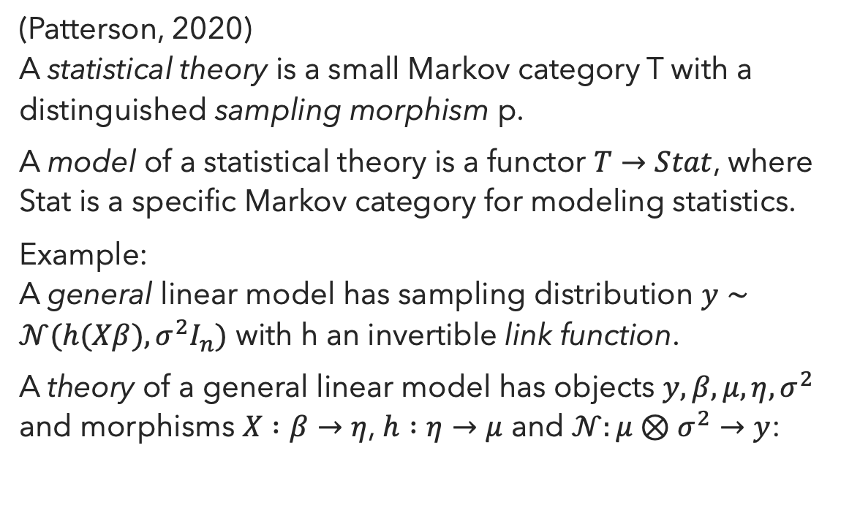

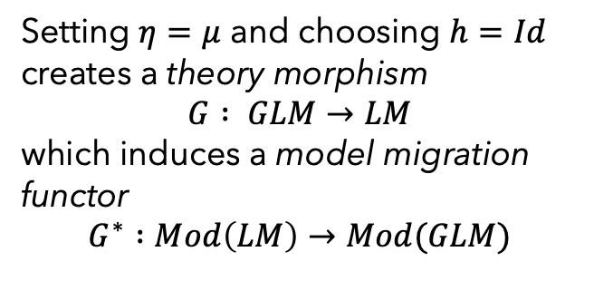
Categorical Statistics:
Theories and Models
(Patterson, 2020)
A statistical theory is a small Markov category T with a distinguished sampling morphism p.
A model of a statistical theory is a functor $T→Stat$, where Stat is a specific Markov category for modeling statistics.
Example:
A general linear model has sampling distribution $y∼𝒩(h(Xβ),σ^{2}I_{n})$ with h an invertible link function.
A theory of a general linear model has objects $y, β, μ, η, σ^{2}$ and morphisms $X :β→η$, $h :η→μ$ and $𝒩:μ⊗σ^{2}→y$:
$$β$$
Setting $η=μ$ and choosing $h=Id$ creates a theory morphism
$$G : GLM→LM$$
which induces a model migration functor
$$G^{∗} :Mod\left(LM\right)→Mod(GLM)$$
X
$$η$$
h
$$σ^{2}$$
$$μ$$
$$𝒩$$
$$y$$

Slide 52
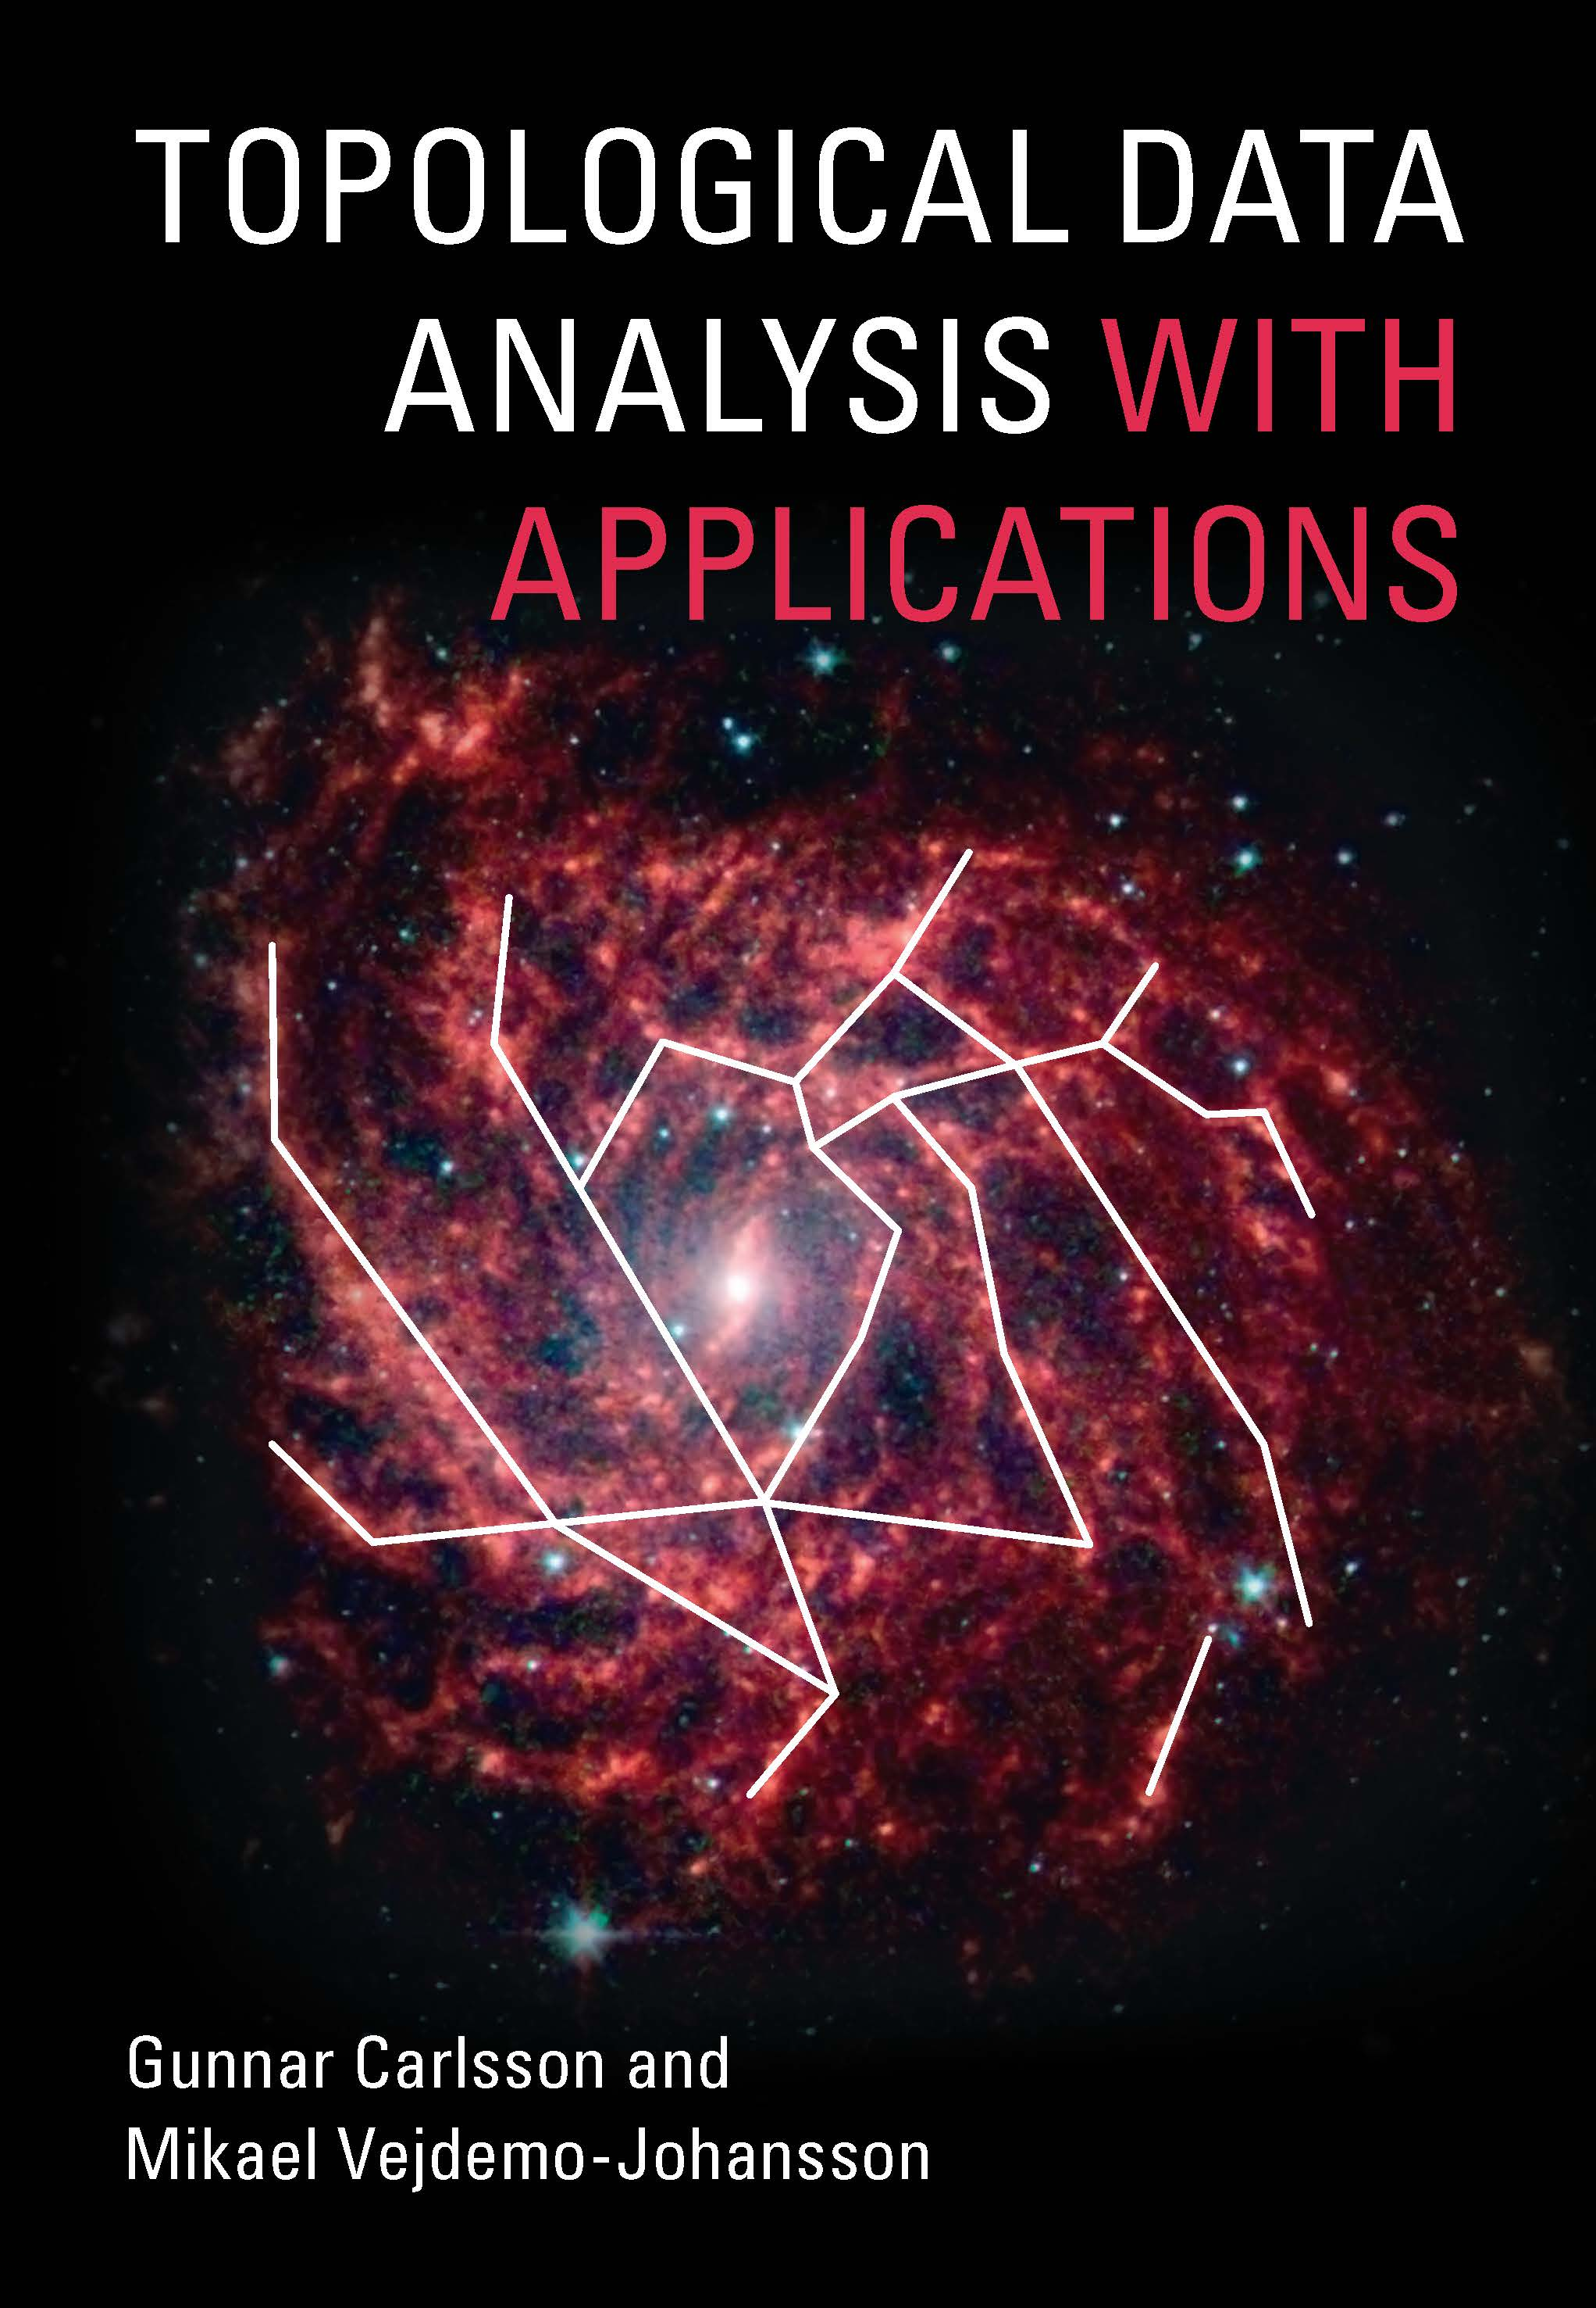
Thank you for listening
Topological Data Analysis
Use linear algebra to compute homology on data sets measuring their clusters, holes and bubbles.
Geometric Data Analysis
Use manifolds to estimate point cloud data.
Information Geometry
Use differentiable manifolds to study parametrized distributions.
Algebraic Statistics
Use algebraic geometry to study statistics – also: use category theory to study statistical models.
www.cambridge.org/9781108838658
20% discount code: TDAA2021

