Slide 1

Multiple Hypothesis Testing with Persistent Homology
Mikael Vejdemo-Johansson (CUNY CSI / GC)
Sayan Mukherjee (MPI Leipzig / Uni Leipzig)
Full paper

Slide 2
Multiple Hypothesis Testing with Persistent Homology Our Contributions
New method for testing whether a persistence diagram is consistent with a null model
New method for controlling Family-Wise Error Rate in persistent homology
New method for controlling False Discovery Rate in persistent homology
Experimental validation of these methods
Experimental power estimation of these methods

Slide 3
Roadmap for this talk
(Quick) Survey Hypothesis Testing in Persistent Homology
Introduce the problem
Testing for consistency with a null model
Multiple testing for consistency with a null model
Power and level estimates, validation

Slide 4
Roadmap for this talk
(Quick) Survey Hypothesis Testing in Persistent Homology
Introduce the problem
Testing for consistency with a null model
Multiple testing for consistency with a null model
Power and level estimates, validation

Slide 5
Hypothesis Testing in Persistent Homology
Interest since the beginning of the research field
Question: Does this persistence diagram show structure?
Question: Which of these persistence diagrams show structure?
Question: Are these persistence diagrams systematically different from those persistence diagrams?

Slide 6
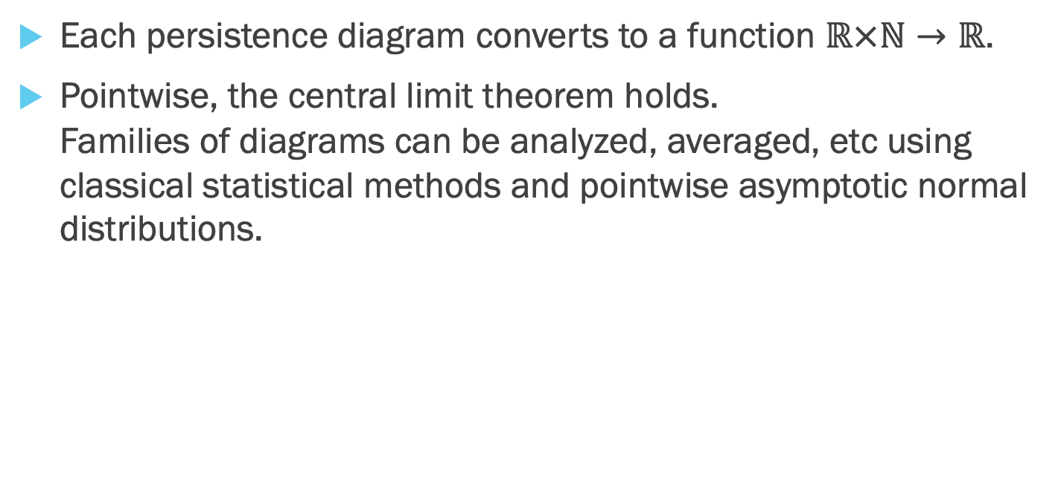
Hypothesis Testing in Persistent Homology Bubenik, Persistence Landscapes
Each persistence diagram converts to a function $ℝ×ℕ→ℝ$.
Pointwise, the central limit theorem holds. Families of diagrams can be analyzed, averaged, etc using classical statistical methods and pointwise asymptotic normal distributions.

Slide 7
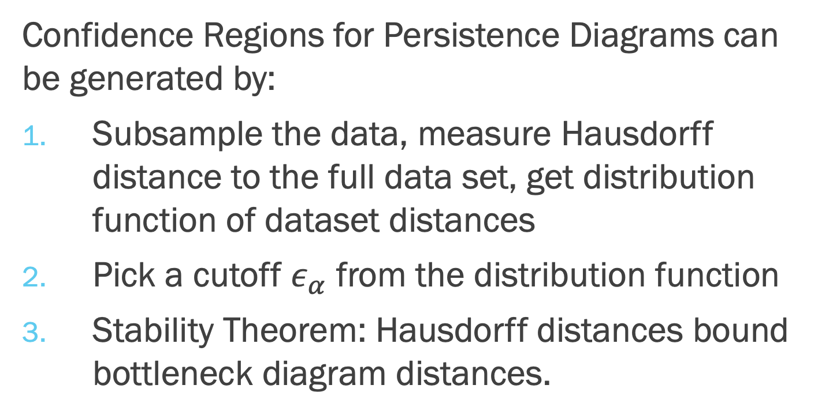
Hypothesis Testing in Persistent Homology Fasy, Lecci, Rinaldo, Wasserman, Balakrishnan, Singh Stability and subsampling
Confidence Regions for Persistence Diagrams can be generated by:
Subsample the data, measure Hausdorff distance to the full data set, get distribution function of dataset distances
Pick a cutoff $ε_{α}$ from the distribution function
Stability Theorem: Hausdorff distances bound bottleneck diagram distances.

Slide 8
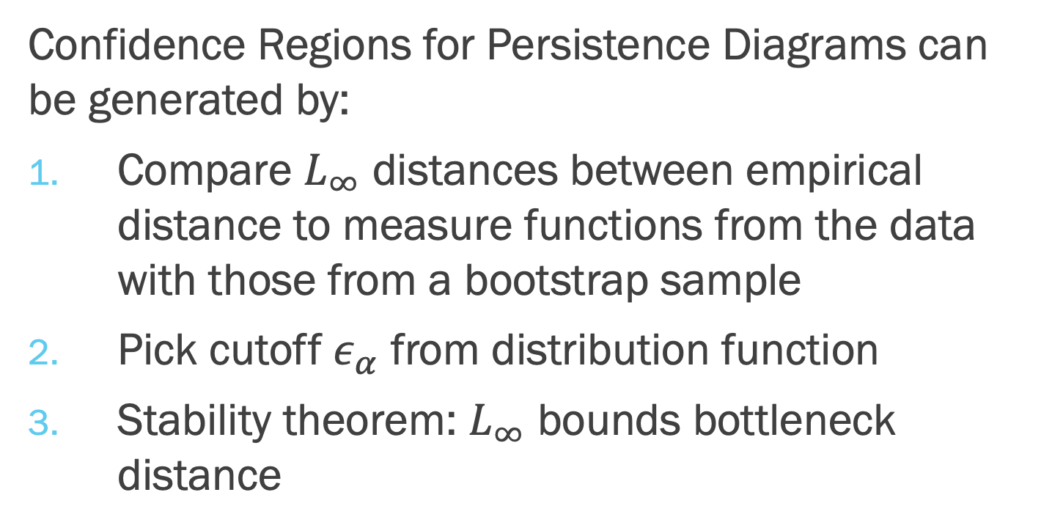
Hypothesis Testing in Persistent Homology Fasy, Lecci, Rinaldo, Wasserman, Balakrishnan, Singh Stability and distance to measure
Confidence Regions for Persistence Diagrams can be generated by:
Compare $L_{∞}$ distances between empirical distance to measure functions from the data with those from a bootstrap sample
Pick cutoff $ε_{α}$ from distribution function
Stability theorem: $L_{∞}$ bounds bottleneck distance

Slide 9
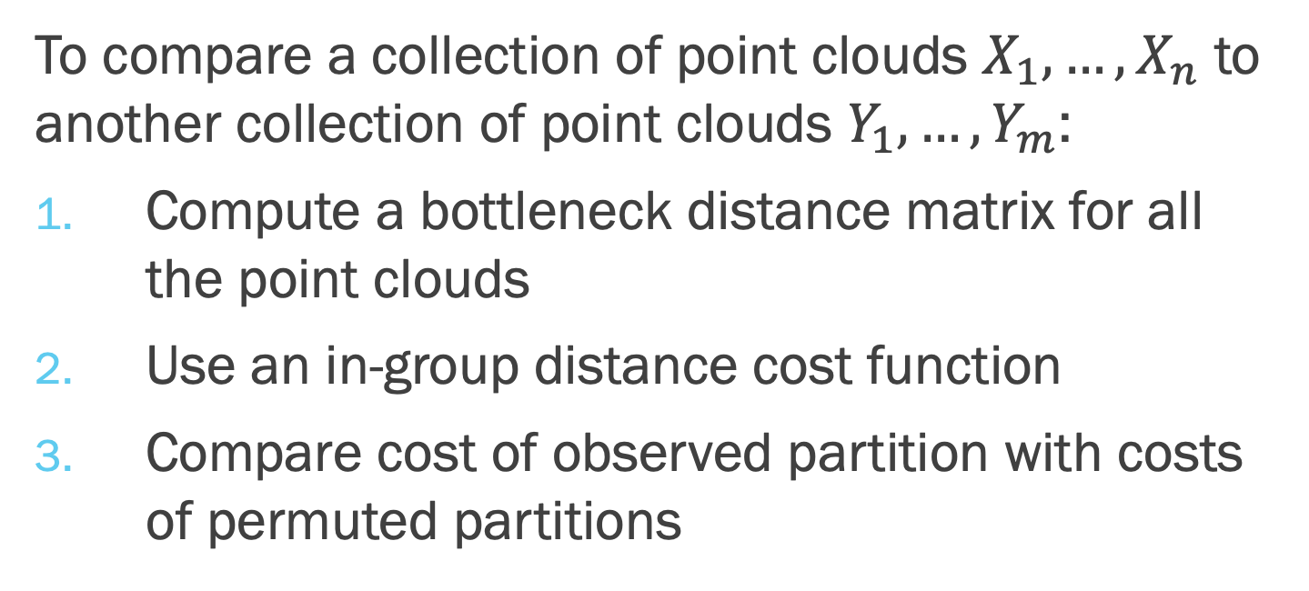
Hypothesis Testing in Persistent Homology Robinson and Turner Two-sample testing
To compare a collection of point clouds $X_{1},…, X_{n}$ to another collection of point clouds $Y_{1}, …, Y_{m}$:
Compute a bottleneck distance matrix for all the point clouds
Use an in-group distance cost function
Compare cost of observed partition with costs of permuted partitions

Slide 10
Hypothesis Testing in Persistent Homology Cericola, Johnson, Kiers, Krock, Purdy, Torrence Multiple sample (ANOVA style) testing
Extend the Robinson-Turner cost function to measure differences between three or more groups of persistence diagrams.
Allows to use permutation testing to perform ANOVA style comparisons between multiple groups of diagrams.
”
If such differences do exist, we then propose using a number of post-hoc (i.e. two-space) permutation tests to identify the specific pairwise differences.

Slide 11
Roadmap for this talk
(Quick) Survey Hypothesis Testing in Persistent Homology
Introduce the problem
Testing for consistency with a null model
Multiple testing for consistency with a null model
Power and level estimates, validation

Slide 12
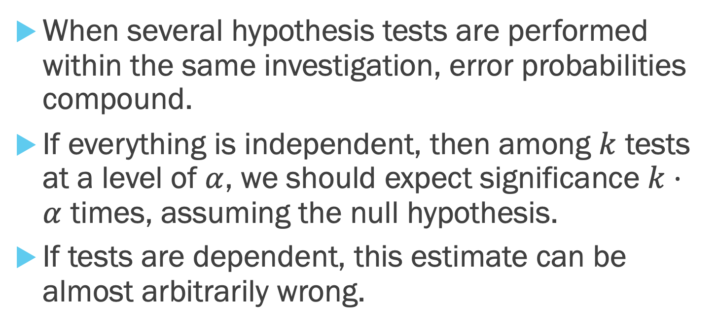
The need for multiple hypothesis testing
When several hypothesis tests are performed within the same investigation, error probabilities compound.
If everything is independent, then among $k$ tests at a level of $α$, we should expect significance $k⋅α$ times, assuming the null hypothesis.
If tests are dependent, this estimate can be almost arbitrarily wrong.

Slide 13
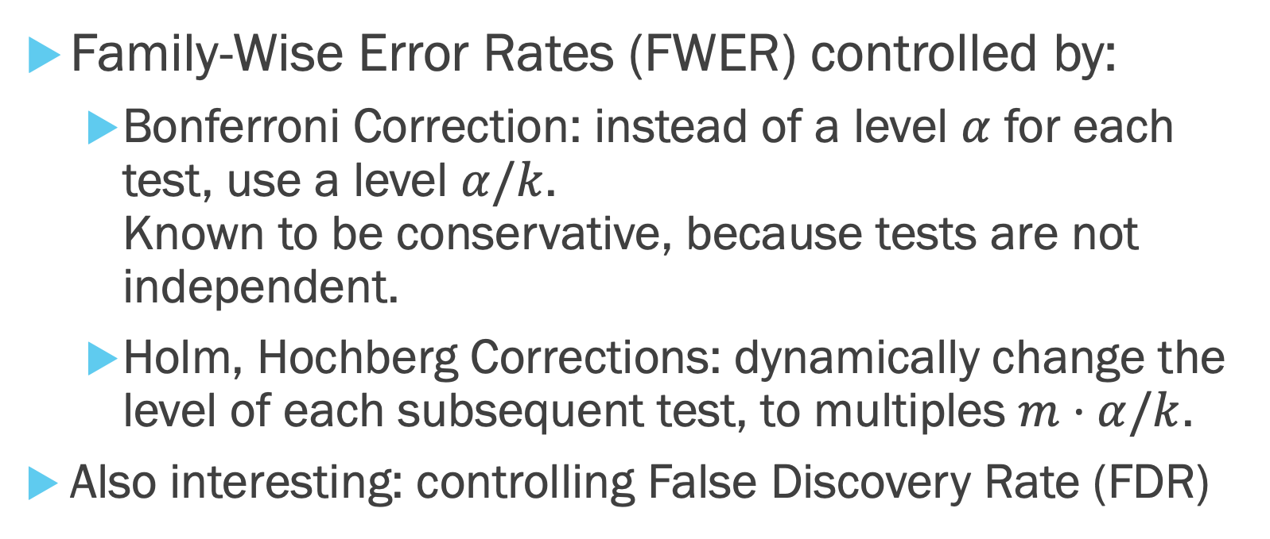
Established methods for multiple hypothesis testing control
Family-Wise Error Rates (FWER) controlled by:
Bonferroni Correction: instead of a level $α$ for each test, use a level $α/k$. Known to be conservative, because tests are not independent.
Holm, Hochberg Corrections: dynamically change the level of each subsequent test, to multiples $m⋅α/k$.
Also interesting: controlling False Discovery Rate (FDR)

Slide 14
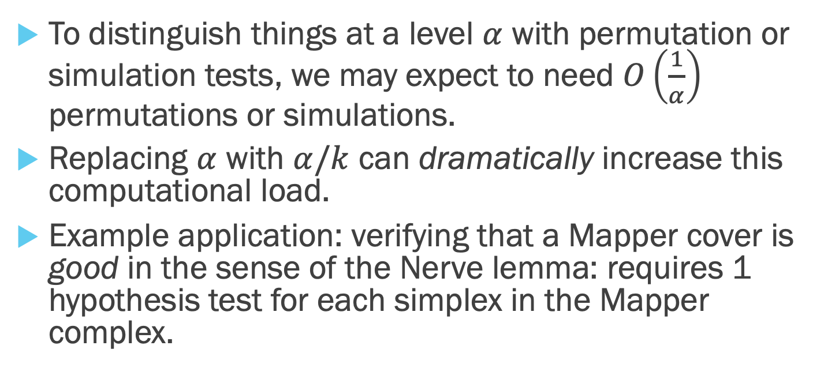
The problem (persistently) with classical correction methods
To distinguish things at a level $α$ with permutation or simulation tests, we may expect to need $O\left(\frac{1}{α}\right)$ permutations or simulations.
Replacing $α$ with $α/k$ can dramatically increase this computational load.
Example application: verifying that a Mapper cover is good in the sense of the Nerve lemma: requires 1 hypothesis test for each simplex in the Mapper complex.

Slide 15
Roadmap for this talk
(Quick) Survey Hypothesis Testing in Persistent Homology
Introduce the problem
Testing for consistency with a null model
Multiple testing for consistency with a null model
Power and level estimates, validation

Slide 16
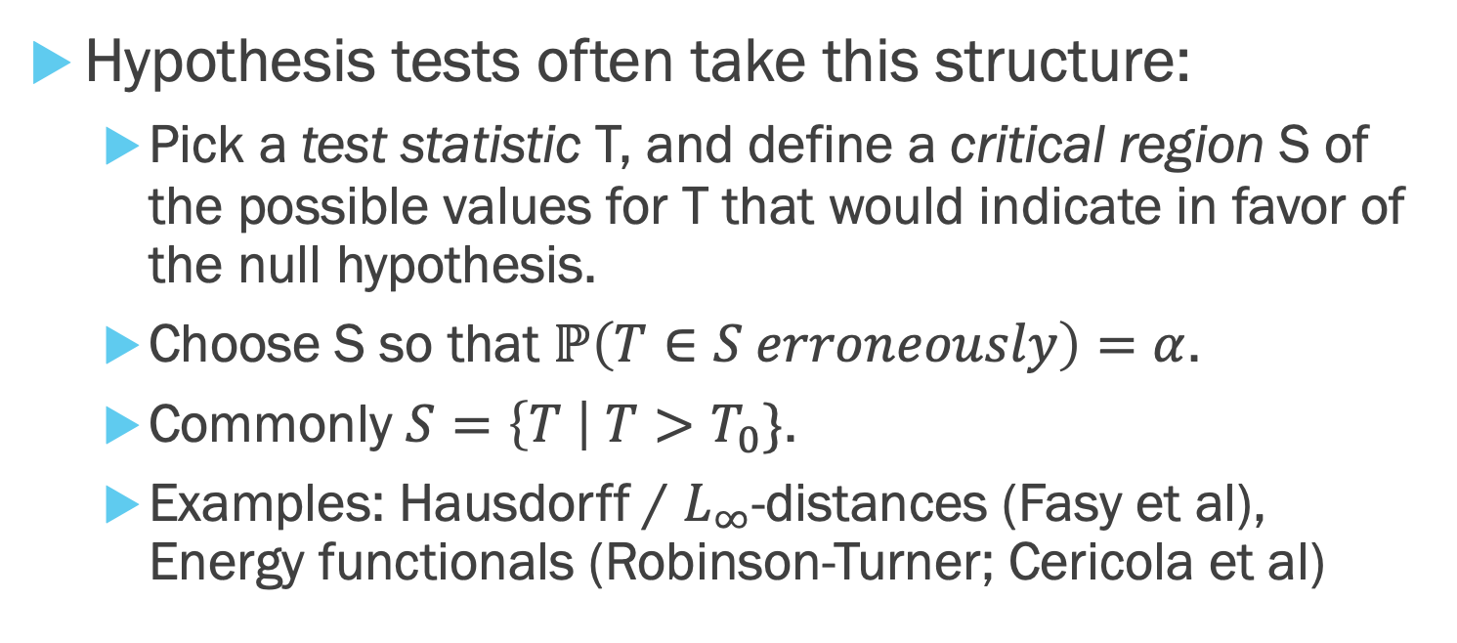
Our Approach One hypothesis
Hypothesis tests often take this structure:
Pick a test statistic T, and define a critical region S of the possible values for T that would indicate in favor of the null hypothesis.
Choose S so that $ℙ\left(T∈S erroneously\right)=α$.
Commonly $S=\left\{T \right| T>T_{0}\}$.
Examples: Hausdorff / $L_{∞}$-distances (Fasy et al), Energy functionals (Robinson-Turner; Cericola et al)

Slide 17
Our Approach Focus on acyclicity
We are interested in finding structure (expressed as non-trivial homology)
Fasy et al: check if confidence regions intersect the diagonal.
These confidence regions are unlikely to be tight estimates.
Our plan: use an explicitly chosen null model for point clouds.

Slide 18
Our Approach Null Model
Bobrowski-Kahle-Skraba: uniformly distributed points in a region have short persistence bars
Spatial Statistics Tradition: uniformly distributed points in a region models Complete Spatial Randomness
One possible null model for acyclicity: uniformly distributed points in an acyclic region (support has no homology)
Which region? Bounding Box? Convex Hull? Unbiased estimators? (we provide and test)

Slide 19
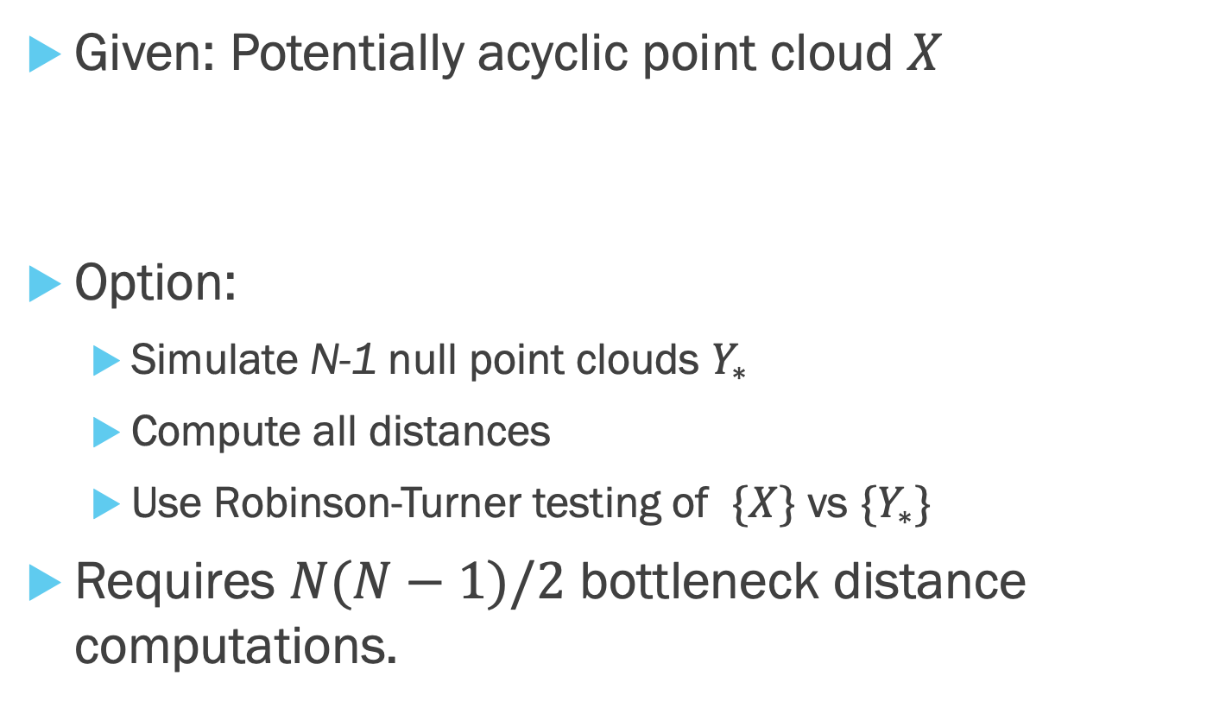
Our Approach Simulation Testing vs. Null Model
Given: Potentially acyclic point cloud $X$
Option:
Simulate N-1 null point clouds $Y_{∗}$
Compute all distances
Use Robinson-Turner testing of $\{X\}$ vs $\{Y_{∗}\}$
Requires $N(N−1)/2$ bottleneck distance computations.

Slide 20
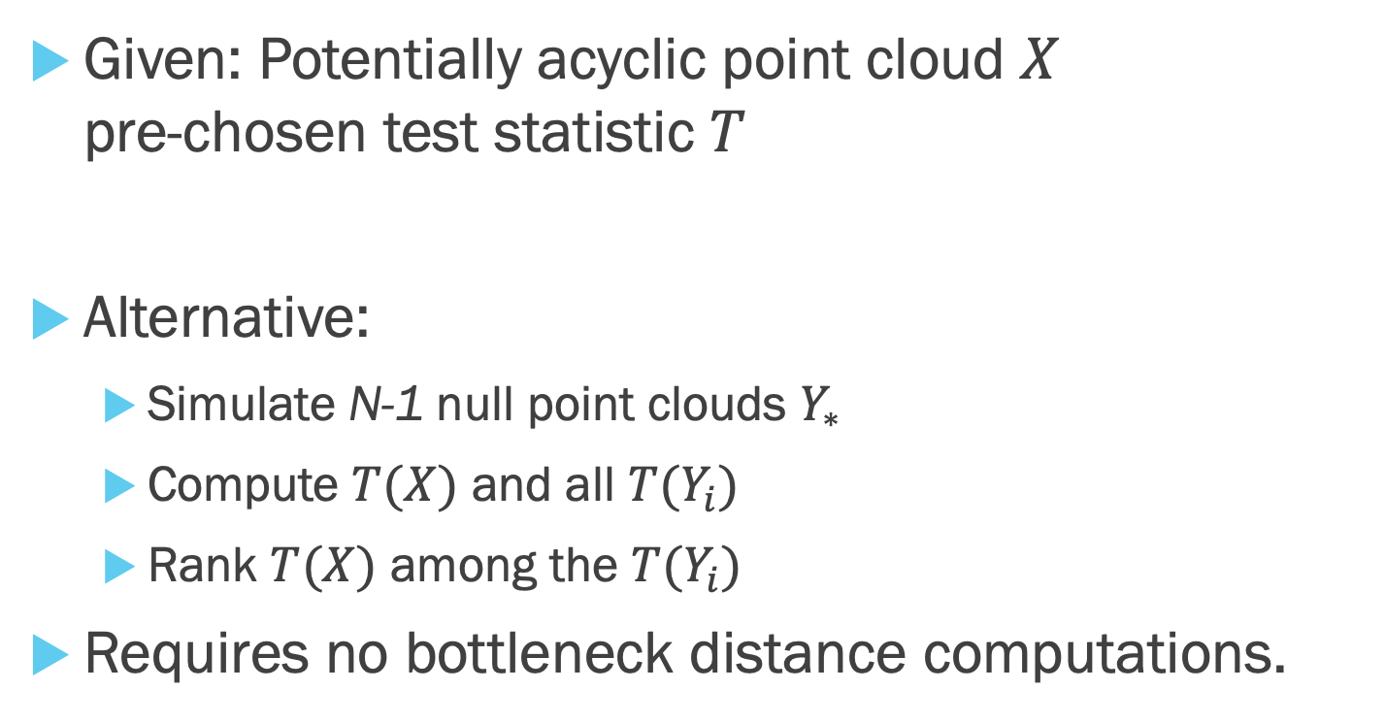
Our Approach Simulation Testing vs. Null Model
Given: Potentially acyclic point cloud $X$ pre-chosen test statistic $T$
Alternative:
Simulate N-1 null point clouds $Y_{∗}$
Compute $T(X)$ and all $T(Y_{i})$
Rank $T(X)$ among the $T(Y_{i})$
Requires no bottleneck distance computations.

Slide 21
Roadmap for this talk
(Quick) Survey Hypothesis Testing in Persistent Homology
Introduce the problem
Testing for consistency with a null model
Multiple testing for consistency with a null model
Power and level estimates, validation

Slide 22
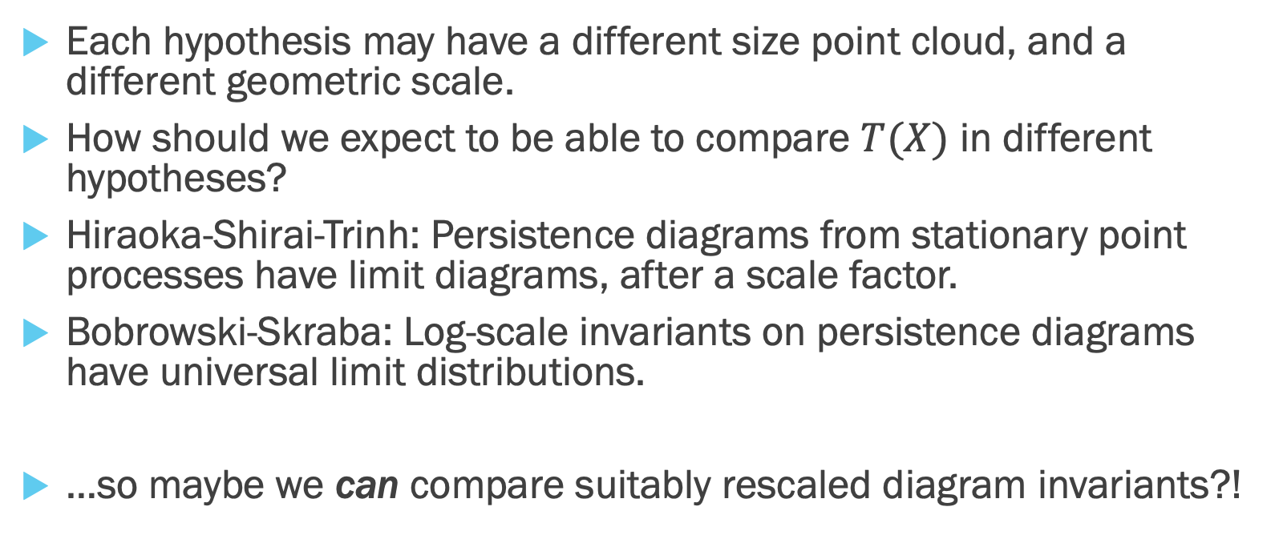
Our Approach Multiple Hypotheses may have different scales
Each hypothesis may have a different size point cloud, and a different geometric scale.
How should we expect to be able to compare $T(X)$ in different hypotheses?
Hiraoka-Shirai-Trinh: Persistence diagrams from stationary point processes have limit diagrams, after a scale factor.
Bobrowski-Skraba: Log-scale invariants on persistence diagrams have universal limit distributions.
…so maybe we can compare suitably rescaled diagram invariants?!

Slide 23
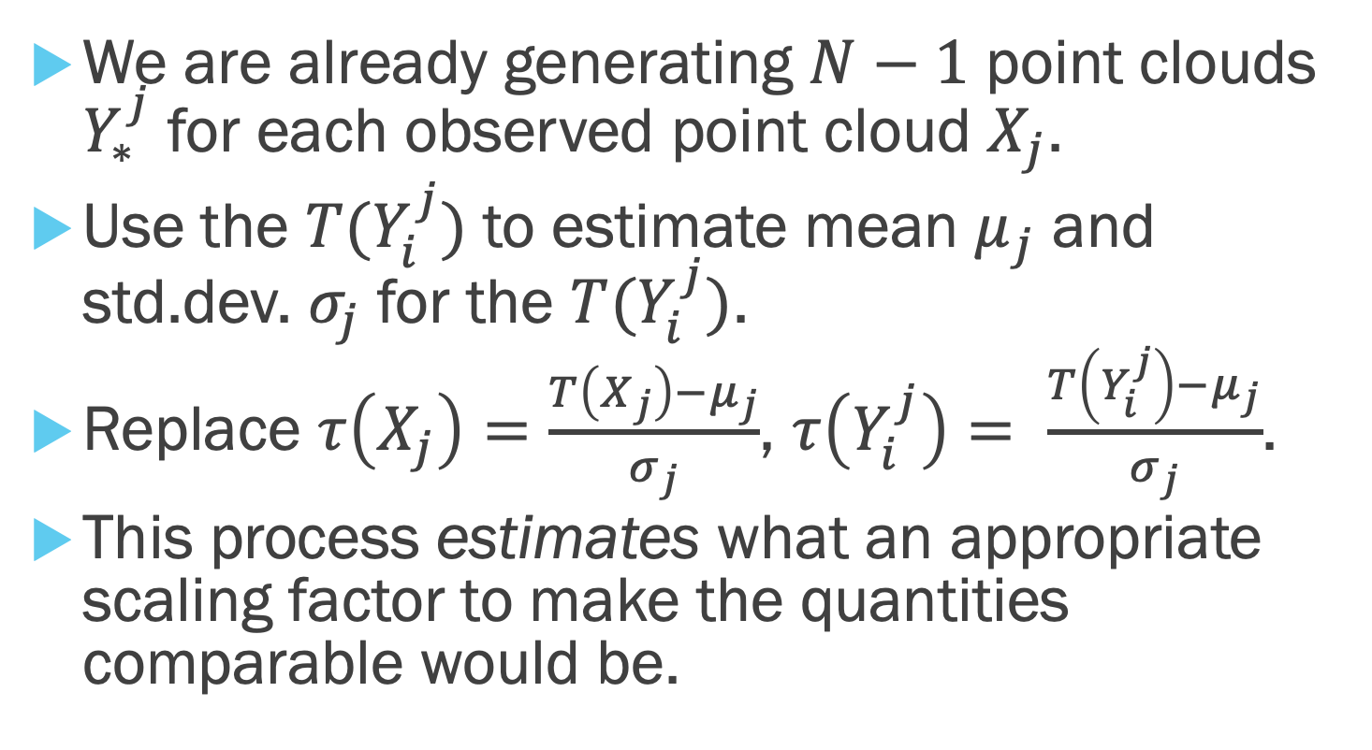
Our Approach Standardization
We are already generating $N−1$ point clouds $Y_{∗}^{j}$ for each observed point cloud $X_{j}$.
Use the $T(Y_{i}^{j})$ to estimate mean $μ_{j}$ and std.dev. $σ_{j}$ for the $T(Y_{i}^{j})$.
Replace $τ\left(X_{j}\right)=\frac{T\left(X_{j}\right)−μ_{j}}{σ_{j}}$, $τ\left(Y_{i}^{j}\right)= \frac{T\left(Y_{i}^{j}\right)−μ_{j}}{σ_{j}}$.
This process estimates what an appropriate scaling factor to make the quantities comparable would be.

Slide 24
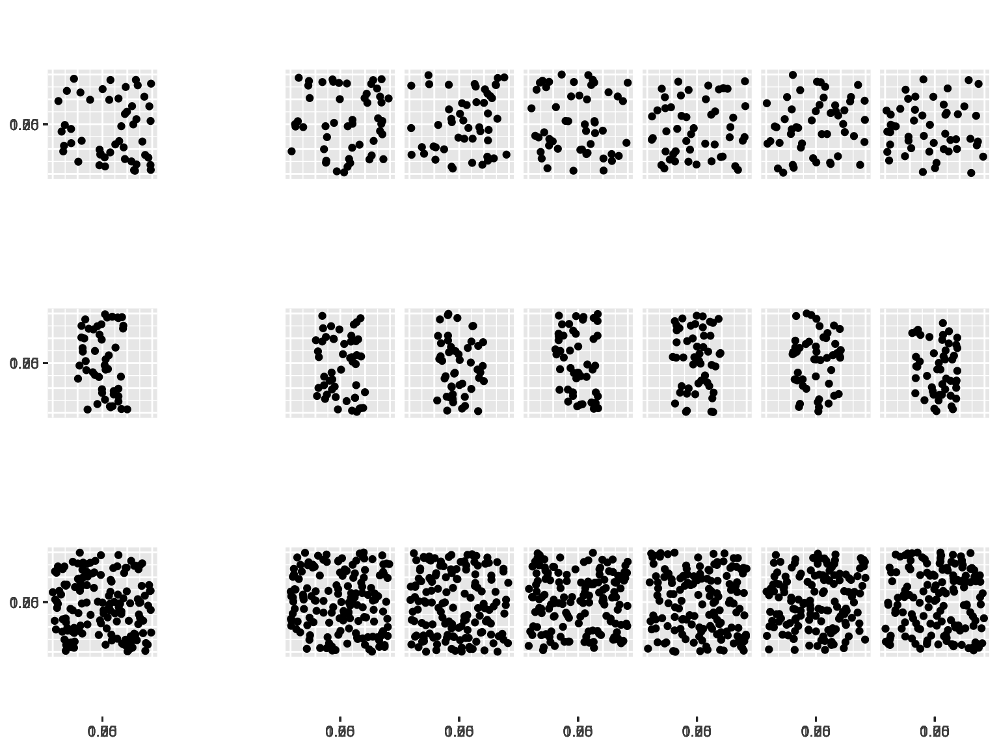
Our Approach A Matrix View
Observed
Simulated

Slide 25





















Our Approach A Matrix View
Estimate row-wise mean and std.dev.
Observed
Simulated
$$T(X_{1})$$
$$T(Y_{1}^{1})$$
$$T(Y_{2}^{1})$$
$$T(Y_{3}^{1})$$
$$T(Y_{4}^{1})$$
$$T(Y_{5}^{1})$$
$$T(Y_{6}^{1})$$
$$T(X_{2})$$
$$T(Y_{1}^{2})$$
$$T(Y_{2}^{2})$$
$$T(Y_{3}^{2})$$
$$T(Y_{4}^{2})$$
$$T(Y_{5}^{2})$$
$$T(Y_{6}^{2})$$
$$T(X_{3})$$
$$T(Y_{1}^{3})$$
$$T(Y_{2}^{3})$$
$$T(Y_{3}^{3})$$
$$T(Y_{4}^{3})$$
$$T(Y_{5}^{3})$$
$$T(Y_{6}^{3})$$

Slide 26
Our Approach A Matrix View
Estimate row-wise mean and std.dev.
Observed
Simulated
$$T(X_{1})$$
$$T(Y_{1}^{1})$$
$$T(Y_{2}^{1})$$
$$T(Y_{3}^{1})$$
$$T(Y_{4}^{1})$$
$$T(Y_{5}^{1})$$
$$T(Y_{6}^{1})$$
$$T(X_{2})$$
$$T(Y_{1}^{2})$$
$$T(Y_{2}^{2})$$
$$T(Y_{3}^{2})$$
$$T(Y_{4}^{2})$$
$$T(Y_{5}^{2})$$
$$T(Y_{6}^{2})$$
$$T(X_{3})$$
$$T(Y_{1}^{3})$$
$$T(Y_{2}^{3})$$
$$T(Y_{3}^{3})$$
$$T(Y_{4}^{3})$$
$$T(Y_{5}^{3})$$
$$T(Y_{6}^{3})$$

Slide 27





















Our Approach A Matrix View
Estimate row-wise mean and std.dev.
Standardize values row-wise
Observed
Simulated
$$τ(X_{1})$$
$$τ(Y_{1}^{1})$$
$$τ(Y_{2}^{1})$$
$$τ(Y_{3}^{1})$$
$$τ(Y_{4}^{1})$$
$$τ(Y_{5}^{1})$$
$$τ(Y_{6}^{1})$$
$$τ(X_{2})$$
$$τ(Y_{1}^{2})$$
$$τ(Y_{2}^{2})$$
$$τ(Y_{3}^{2})$$
$$τ(Y_{4}^{2})$$
$$τ(Y_{5}^{2})$$
$$τ(Y_{6}^{2})$$
$$τ(X_{3})$$
$$τ(Y_{1}^{3})$$
$$τ(Y_{2}^{3})$$
$$τ(Y_{3}^{3})$$
$$τ(Y_{4}^{3})$$
$$τ(Y_{5}^{3})$$
$$τ(Y_{6}^{3})$$

Slide 28









Our Approach A Matrix View
Estimate row-wise mean and std.dev.
Standardize values row-wise
Take column-wise maxima
Rank the column maxima
Observed
Simulated
$$τ(X_{1})$$
$$τ(Y_{1}^{1})$$
$$τ(Y_{2}^{1})$$
$$τ(Y_{3}^{1})$$
$$τ(Y_{4}^{1})$$
$$τ(Y_{5}^{1})$$
$$τ(Y_{6}^{1})$$
$$τ(X_{2})$$
$$τ(Y_{1}^{2})$$
$$τ(Y_{2}^{2})$$
$$τ(Y_{3}^{2})$$
$$τ(Y_{4}^{2})$$
$$τ(Y_{5}^{2})$$
$$τ(Y_{6}^{2})$$
$$τ(X_{3})$$
$$τ(Y_{1}^{3})$$
$$τ(Y_{2}^{3})$$
$$τ(Y_{3}^{3})$$
$$τ(Y_{4}^{3})$$
$$τ(Y_{5}^{3})$$
$$τ(Y_{6}^{3})$$
$$\max_{j}{τ(X_{j})}$$
$$\max_{j}{τ(Y_{1}^{j})}$$
$$\max_{j}{τ(Y_{3}^{j})}$$
$$\max_{j}{τ(Y_{5}^{j})}$$
$$\max_{j}{τ(Y_{2}^{j})}$$
$$\max_{j}{τ(Y_{4}^{j})}$$
$$\max_{j}{τ(Y_{6}^{j})}$$

Slide 29
Roadmap for this talk
(Quick) Survey Hypothesis Testing in Persistent Homology
Introduce the problem
Testing for consistency with a null model
Multiple testing for consistency with a null model
Power and level estimates, validation

Slide 30
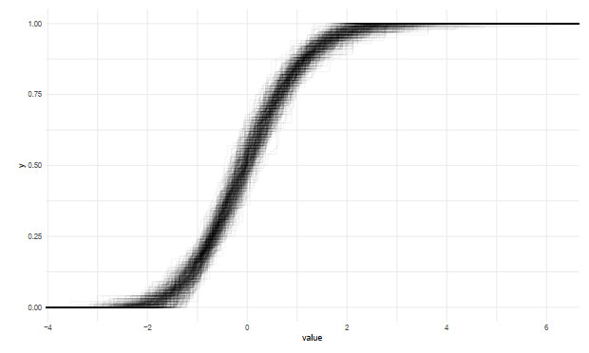
Question: Do the invariants in fact compare?
ECDF of standardized invariants for 100 acyclic models, 100 point clouds per model

Slide 31
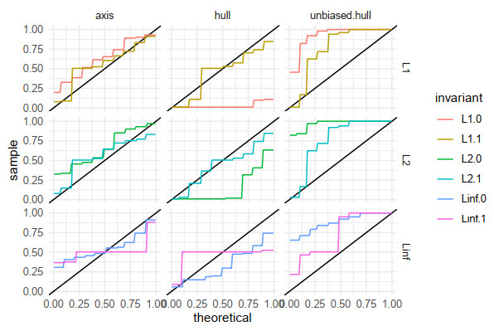
Question: Does picking an unbiased convex hull estimator matter?
QQ-plots of simulation p-values against a uniform distribution,
split on unbiased bounding box (left), biased convex hull (middle) and bias-corrected convex hull (right)

Slide 32
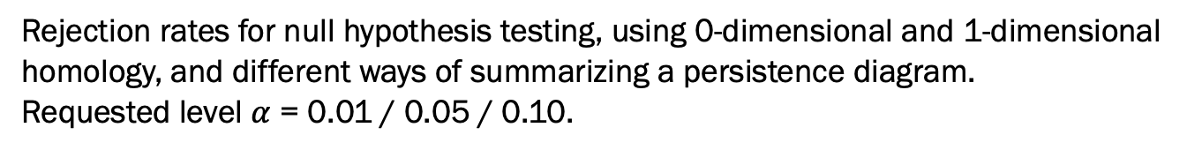
Question: Does picking an unbiased convex hull estimator matter?
Rejection rates for null hypothesis testing, using 0-dimensional and 1-dimensional
homology, and different ways of summarizing a persistence diagram.
Requested level $α$ = 0.01 / 0.05 / 0.10.
Invariant | axis | hull | unbiased hull
Linf.0 | .08/.15/.28 | .21/.29/.38 | .02/.05/.05
Linf.1 | .03/.07/.10 | .02/.10/.22 | .03/.03/.05
L1.0 | .00/.00/.08 | .94/.96/.96 | .00/.03/.09
L1.1 | .06/.06/.24 | .10/.26/.36 | .08/.08/.10
L2.0 | .05/.09/.13 | .82/.88/.92 | .00/.00/.06
L2.1 | .06/.13/.28 | .22/.32/.44 | .05/.08/.12

Slide 33
Thank you for your attention
Work supported by:
Nvidia, Simons Foundation, HFSP, NSF, North Carolina Biotechnology Center
The full paper contains extensive experiments both to validate the methods (with tables of rejection rates), and to measure discriminative power (with a range of different topological shapes to detect)
Full paper

