Slide 1
More (tie)knots than we thought
Geometry, Topology, Knot theory, Formal Languages and Grammars, Combinatorics, Gröbner bases, Group theory
Mikael Vejdemo-Johansson
CUNY College of Staten Island
CUNY Graduate Center

Slide 2
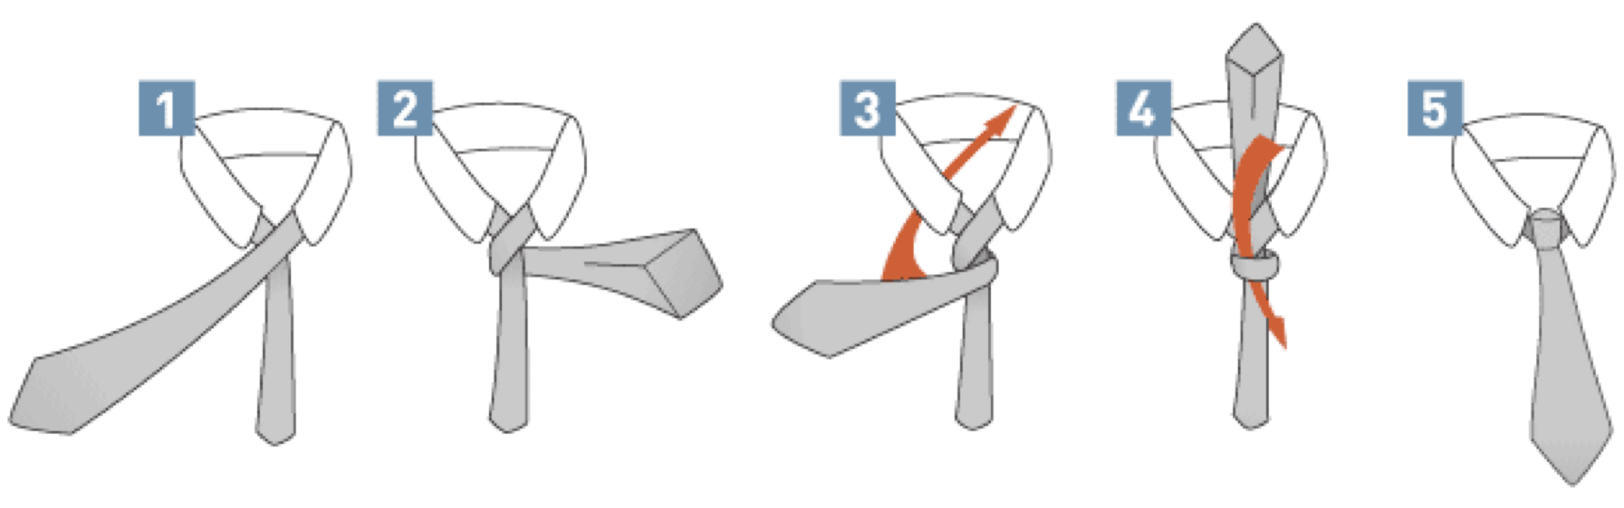
Let’s Tie a Tie
Now for the question: how would you describe this over the phone?

Slide 3
Fink and Mao (2000)
Cambridge Physicists Thomas Fink and Yong Mao tried to count all possible necktie knots
To do this, they invented a notation for describing tieknots:
A knot is determined by a sequence of zones that the active tie end moves through.
Fink & Mao also used inwards/outwards notations (with symbols ⊙, ⊗), but they get tedious to write out and can be inferred.

Slide 4
Some Very Common Tie Knots
L – Left C – Center
R – Right U - Under
4-in-hand | LRLCU
Half Windsor | LRCLRCU
Windsor | LCRLCRLCU

Slide 5
So… How many knots are possible?
Fink and Mao found 85 tie knots.
Using their symbols + the following rules:
Forbidden sequences: LL, CC, RR ⊙⊙, ⊗⊗
Prescribed ending: LRCU or RLCU
Prescribed maximum length: 9 moves

Slide 6
More Ties than we Thought
My own contribution, PeerJ Computer Science 2015
Numerous modern tieknots were created in the current millenium that do not follow the prescribed endings. …so they are not counted in Fink&Mao’s enumeration.
We simplify the notation, remove the prescribed endings and encode the other rules by a symbol change.

Slide 7
Changing the Tie Language
3 regions, no region can be repeated ⇒ only two directions matter
Instead of L/R/C, we use Widdershins (counter-clockwise) and Turnwise (clockwise)
Remaining rules for the language govern when the tucking Under moves can be used:
Theorem: Tucking under k layers of the tieknot is a valid move if the subsequence of the 2k moves preceding the tuck is one of:
starts with W, and #W - #T = 2 (mod 3)
starts with T, and #T - #W = 2 (mod 3)

Slide 8
Try Some Novel Knots
Thin blade active |  | Thick blade active | (start inverted)
Edeity | LCLRCRLCU | Kelvin | LRLRCU
Trinity | LCLRCRLCURLU | Pratt | LCLRCU
Eldredge | LCRLRCRLUCRCLU | Hanover | LRCLRCLRCU
Allwin | LCLRCLRLRCUULRU | Balthus | LCRCLCRLCU
Atlantic | LCRLCU | Oriental | LRCU
UU in the notation for the Allwin means go under the 2nd to last bow over the knot

Slide 9
Formal Languages and Enumeration
Sequences of symbols (like these) with rules for which sequences are considered valid is the subject of study for Formal Languages
Counting tie knots is done by counting possible valid strings in the language that describes the knot notation.
Enumeration was greatly improved when Paul-Olivier Dehaye pointed out Chomsky and Schützenberger’s theorem from 1959.

Slide 10
Chomsky – Schützenberger 1959
Well described by Gruber– Lee – Shallit (preprint in 2012)
Translate the grammar to a system of algebraic equations
Solve the system for the root grammar symbol
The resulting solution is a generating function for words generated by that symbol.

Slide 11
Translate Grammar to Equations
Suppose each symbol S in the grammar has some generating function S(t).
(X|Y)(t) = X(t) + Y(t)
(XY)(t) = X(t)Y(t)
X* = 1 | X | XX | XXX | …, so X*(t) = 1 + X(t) + X(t)² + X(t)³ + X(t)⁴ + X(t)⁵ + … = 1/(1-X(t))

Slide 12
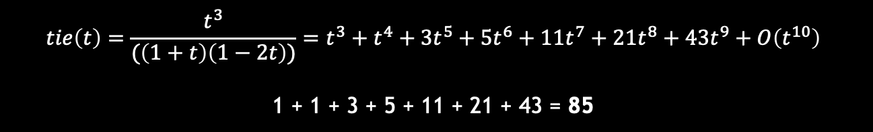
Fink & Mao
tie → L lastL
lastL → R lastR | C lastC | RCU
lastR → L lastL | C lastC | LCU
lastC → L lastL | R lastR
tie(t) = t lastL(t)
lastL(t) → t lastR(t) + t lastC(t) + t²
lastR(t) → t lastL(t) + t lastC(t) + t²
lastC(t) → t lastL(t) + t lastR(t)
$$tie\left(t\right)=\frac{t^{3}}{(\left(1+t\right)\left(1−2t\right))}=t^{3}+t^{4}+3t^{5}+5t^{6}+11t^{7}+21t^{8}+43t^{9}+O\left(t^{10}\right)$$
1 + 1 + 3 + 5 + 11 + 21 + 43 = 85

Slide 13
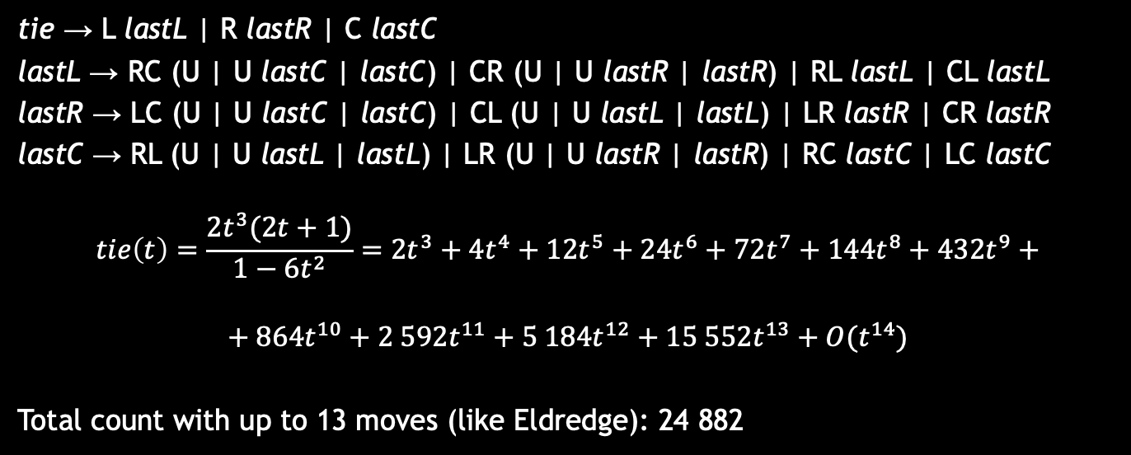
Only Allow Single Depth Tucks
tie → L lastL | R lastR | C lastC
lastL → RC (U | U lastC | lastC) | CR (U | U lastR | lastR) | RL lastL | CL lastL
lastR → LC (U | U lastC | lastC) | CL (U | U lastL | lastL) | LR lastR | CR lastR
lastC → RL (U | U lastL | lastL) | LR (U | U lastR | lastR) | RC lastC | LC lastC
$$tie\left(t\right)=\frac{2t^{3}(2t+1)}{1−6t^{2}}=2t^{3}+4t^{4}+12t^{5}+24t^{6}+72t^{7}+144t^{8}+432t^{9}+$$ $$+ 864t^{10}+2 592t^{11}+5 184t^{12}+15 552t^{13}+O(t^{14})$$
Total count with up to 13 moves (like Eldredge): 24 882

Slide 14
Full Tieknot Grammar
T/W/U notation. Context-free recursive. The states w0, w1, w2 track the balance of #W vs. #T. ‘ corresponds to building a sequence of tucks – UU’U is a UU followed by a U.
tie → (T|W)?(pair|tuck)*tuck
pair → TT | TW | WT | WW
tuck → ttuck | wtuck
ttuck → TT w0 U | TW w1 U
wtuck → WW w0 U | WT w2 U
w0 → WW w1 U | WT w0 U | TW w0 U | TT w2 U | ttuck ‘ w2 U | wtuck ‘ w1 U | ε
w1 → WW w2 U | WT w1 U | TW w1 U | TT w0 U | ttuck ‘ w0 U | wtuck ‘ w2 U | ε
w2 → WW w0 U | WT w2 U | TW w2 U | TT w1 U | ttuck ‘ w1 U | wtuck ‘ w0 U | ε

Slide 15
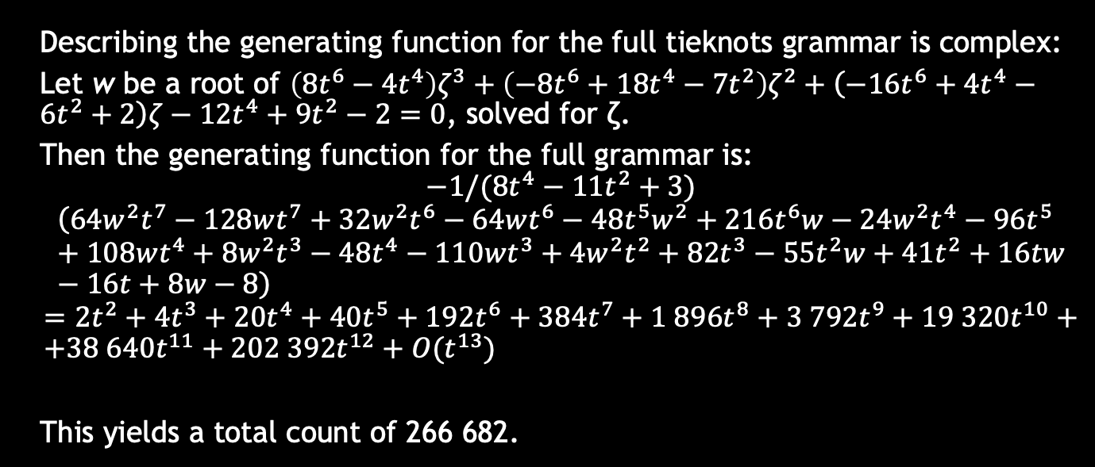
Full Tieknot Enumeration
Describing the generating function for the full tieknots grammar is complex:
Let w be a root of $\left(8t^{6}−4t^{4}\right)ζ^{3}+\left(−8t^{6}+18t^{4}−7t^{2}\right)ζ^{2}+\left(−16t^{6}+4t^{4}−6t^{2}+2\right)ζ−12t^{4}+9t^{2}−2=0$, solved for ζ.
Then the generating function for the full grammar is:
$$−1/(8t^{4}−11t^{2}+3)$$
$$\left(64w^{2}t^{7}−128wt^{7}+32w^{2}t^{6}−64wt^{6}−48t^{5}w^{2}+216t^{6}w−24w^{2}t^{4}−96t^{5}+108wt^{4}+8w^{2}t^{3}−48t^{4}−110wt^{3}+4w^{2}t^{2}+82t^{3}−55t^{2}w+41t^{2}+16tw−16t+8w−8\right)$$
$$=2t^{2}+4t^{3}+20t^{4}+40t^{5}+192t^{6}+384t^{7}+1 896t^{8}+3 792t^{9}+19 320t^{10}+ \\ +38 640t^{11}+202 392t^{12}+O(t^{13})$$
This yields a total count of 266 682.

Slide 16
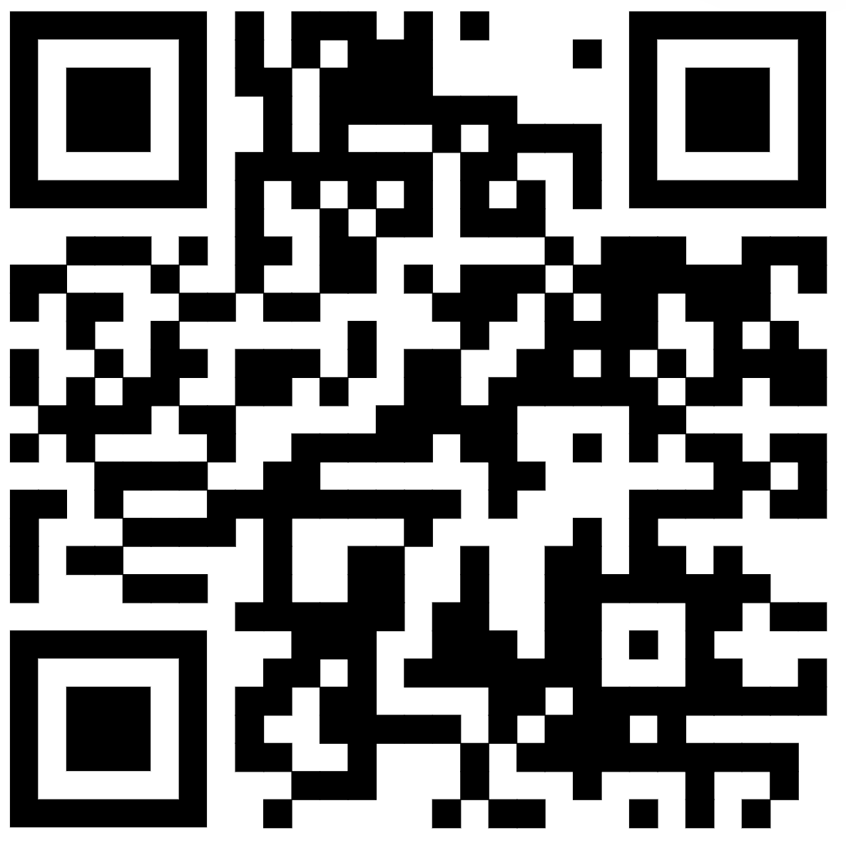
Thank You…
For more details: https://tieknots.how
…everyone in the audience for coming early and listening
…the session organizers for inviting me to speak
…Simons Foundation for providing my travel funding

